Slide 1
LDO/CWO In Service Procurement
Selection Boards
Navy Personnel Command
Administrative Selection Boards (PERS-803)
March 2017

Slide 2
Topics of Discussion
  Eligibility
  Communicating with the board
  Pre board
  Membership
  Quotas
  Tools of the board
  Available for Review
  Not Available for Review
  What the Board Considers
  Board Process Overview
  Post Board Process
  Common Issues/FAQs/Myths

Slide 3
Eligibility
  Read the announcing NAVADMIN and Chapters 2 and 7 and
  Appendix F of OPNAVINST 1420.1B
    Where conflicts exist, follow the NAVADMIN.
  FY18 eligibility
    LDO ENS: E6 to E9 with 8-14 years time in service
      E6 applicants must have 1 year TIR as of 1 October of calendar year of application (1 Oct 17 for FY18 board) and pass the E7 exam
    CWO: E7 to E9 with 14-20 years time in service
    CWO to LTJG: 14-16 years time in service and 2 years time in grade
  Additional requirements
    U.S. citizenship
    High school graduate or GED
    Color vision test (for certain designators)
    No NJP/civil conviction in the last three years as of 1 October of calendar year of application (1 Oct 16 for FY 18 board)
Notes:
Eligibility requirements are published in the announcing NAVADMIN and chapters 2 and 7 and Appendix F of OPNAVINST 1420.1B. Make sure that you incorporate changes made by NAVADMIN 281/12 into OPNAVINST 1420.1B as there have been changes since the instruction was published.
Eligibility for the FY18 (January 2017) board are on the slide. There may be changes so always review the announcing NAVADMIN.
Contrary to popular belief, not everything is waiviable. Especially these additional requirements.

Slide 4
Eligibility
  Application packages must be complete
    PERS 803 checks each package using the same eligibility checklist that applicants and commands should be using
    Any information that is required but not provided may result in a determination of “not eligible”
  To resolve eligibility issues, contact PERS-803 prior to application due date.
Notes:
Your application package is also used to determine your eligibility. An incomplete package may make you ineligible. For example, if you do not fill in block 29 (Civilian/military offense(s)), NPC cannot verify that you have not been in trouble in the last three years, so there is no positive confirmation that you are eligible.

Slide 5
Communicating with the Board
  Your application is your means to communicate with the board
    Discuss your application with your LDO/CWO mentor
    Consider having an experienced board member review your OMPF with you
    Submit items you want considered that are missing from your OMPF as enclosures to your application
    NSIPS Electronic Service Record (ESR) data is not available to the board unless it is also in your OMPF
    Documents forwarded to selection boards do not update your OMPF
    Any addendums must come from and be signed by you and have command endorsement. Addendums not signed by the applicant are considered third-party correspondence and not presented to the board
Notes:
The application and any addendums are your communications to the board. You can send anything that you want the board to consider. The board already sees field codes 30 through 38 of your OMPF. There is no need to send duplicates.
All correspondence must come from you as the applicant via your CO. You must sign anything you send, otherwise there is not positive confirmation that it came from you and will be deemed third-party correspondence, which is not presented to the board. Your signature may be a wet signature (signing the paper with a pen) or your digital signature using your CAC.

Slide 6
Communicating with the Board
  Your application is your means to communicate with the board
    DO NOT
      Send originals of source documents, they will not be returned
      Send duplicates of items already in your OMPF
      Send Joint Service Transcripts (JST)
      Highlight items on your documents. They may become illegible when scanned into the selection board system
    DO:
      Pay close attention to due dates on the announcing NAVADMIN
      Include your FULL SSN on each page submitted
Notes:
Again, the application and any addendums are your communications to the board. You can send anything that you want the board to consider. However, NPC recommends that you DO NOT: [see slide]

Slide 7
Pre-Board
    PERS-8 Actions
        Scrub eligibility
          Each application is checked against the eligibility checklist
          Errors are posted to BOL and updated weekly
          Errors that are not corrected may result in a determination of “not eligible” for the board
      100% accountability and verification of addendums
        Each addendum is added to the original application
        There is no method to update BOL for addendums
        Addendums received after the “received by” date published in the announcing NAVADMIN are not presented to the board
Notes:
As applications are received, PERS 803 scrubs each one individually for eligibility. As a courtesy to applicants, error codes are posted on BOL, giving you the opportunity to correct or submit additional information. Since each application must be manually scanned into the selection board system, there has to be a firm deadline for applications to be ready for the scanners in order for them to be in the system when recorders arrive. You will have had plenty of time to correct errors by that date, so any outstanding errors will likely make you not eligible.
Each addendum that is sent is added to the original applications. BOL does not get updated when you submit an addendum. You can call the Customer Service Center or a PERS 803 representative to see if your addendum was received.
Note that addendums have a “received by” date instead of a “postmarked” date. If your addendum was not received by 2359 on the date announced in the NAVADMIN it will not be presented to the board.

Slide 8
Membership
  Membership demographics
    Requested Designators Race
    Gender Geographic Location
    Special Qualifications Component
    Prior Board Experience Number of reviews
      Up to five panels for record review. For example
  Admin/Supply Panel
  Surface Ops Panel
  Aviation Panel
  Information Warfare Panel
  NUC Panel
      1 LDO captain (President who is a member of all panels)
      1 URL on each panel
      ~ 60 members total
Notes:
From SECNAVINST 1401.3A, para 4a.: “Board members should be selected from a wide range of leadership positions and reflect the composition of the officer corps, including women and racial or ethnic minorities.” PERS 805 receives board member and board recorder applications from detailers then builds the board membership to closely reflect the demographics of the applicants. Members and recorders are notified of their selection as board members and recorders approximately a month prior to the board convening. Membership MUST NOT be compromised. Members must not divulge the purpose, location, or dates of travel to anyone except their Commanding Officer/Reporting Senior. They may divulge only the location and dates of travel to an individual designated by their Commanding Officer/Reporting Senior for coordinating travel.

Slide 9
Quotas
    Recommended by Officer Community Managers
    Approved by Chief of Naval Personnel
    Made public when board convenes
    May go unfilled when insufficient number of candidates meet “fully qualified” standard
Notes:
Quotas are vacancy driven, approved by the Chief of Naval Personnel, and are made public after the board convenes.
Applicants must meet the “fully qualified” standard to be selected. Quotas may go unfilled (also known as returned) when an insufficient number of applicants in a competitive group meet the “fully qualified” standard to fill that competitive group’s quotas.

Slide 10
Tools of the Board
    The convening order from the Chief of Naval Personnel to the Board President provides
      Date board ordered to convene
      The selection standard (best and fully qualified)
      Board Membership
    The quota letter from the Chief of Naval Personnel provides
      Number of authorized primary and alternate selects for each designator
      Discrete requirements for each designator
        Outlines the best qualified considerations
        Assist the board members in providing community briefs to their panels
Notes:
The Convening Order provides the board’s membership and explains the best and fully qualified standard. The quota letter lists quotas and discrete requirements for each designator. Both are made public after the board convenes and posted on NPC’s LDO/CWO board webpage.
The discrete requirements are the answer to “What is the board looking for?”. Potential applicants should be reviewing them each year and making career decisions that reflect the experience for which the communities are looking. Appraisal boards should be using them when conducting interviews to help determine if the candidate is ready. These requirements are in the quota letter which is also made public after the board convenes and is posted on NPC’s LDO/CWO board webpage.

Slide 11
Available for Review
  Official Military Personnel File (OMPF) field codes 30-38
    Available via BOL menu item “OMPF-My Record”
  Performance Summary Record (PSR)
    Available via BOL menu item “ODC, OSR, PSR”
    Part I (Personnel Data Summary)
    Part II (Pre-1996 evaluation summary)
    Part III (1996 to present evaluation summary)
  Candidate’s Application
    Including any authorized addendums
Accuracy of these three items may be the difference between select and non-select
Notes:
You can see OMPF field codes as a column when you look at your OMPF via BOL.
To help alleviate confusion in terminology between the Enlisted Summary Record (ESR) and the Electronic Service Record (ESR), the Enlisted Summary Record was renamed the "Personnel Data Summary" or commonly known as the Performance Summary Record Part 1.
On BOL, the menu item was changed to “ODC/OSR/PSR,” removing ESR.
The PSR Part I contains the Personnel Data Summary; PSR Part II is the Evaluation Summary (Pre-1996 Form); and PSR Part III is the Evaluation Summary (1996 to Present).
Your application and any authorized addendums are also provided to the board. Reasons for addendums not being presented are covered next.

Slide 12
Not Available for Review
  NSIPS ESR data not in the OMPF
    Should have been forwarded to the OMPF at time of reenlistment/record close-out.
  ESR, FLTMPS, ETJ
  PRIMS information
  Items sent to the board by anyone other than by the candidate (third-party correspondence)
  Addendums that are not signed or that are received after the “received by” date
If you want the board to consider items not in your OMPF, you must submit them.
Notes:
It was covered earlier, but it is important, so again: All correspondence must come from you as the applicant via your CO. You must sign anything you send; otherwise there is not positive confirmation that it came from you and will be deemed third-party correspondence, which is not presented to the board. Your signature may be a wet signature (signing the paper with a pen) or your digital signature using your CAC. Unsigned or late addendums are not presented to the board.

Slide 13
What the Board Considers
  Appraisals and CO’s Recommendations
      Strong, honest recommendations and comments from appraisals
      Command endorsement communicates potential to succeed as an officer
  Evaluations
        Trait average vs summary group and reporting senior’s cumulative average
        Break out among peers
        Promotion recommendation
          Consistent? Improving? Declining?
Notes:
Appraisers and COs: You are writing to the board, not to the applicant to make him/her feel good. Be conscious of mixed messages, both between your evaluative blocks and comments and between the appraisal comments and CO recommendations. OPNAVINST 1420.1B chapter 7 has good guidance for COs when writing their recommendations.

Slide 14
What the Board Considers
  Description of duties
        Demonstrated leadership
        Technical expertise
      Success at sea/arduous duty
      Initiative
      Education and professional development
Notes:
Read the convening order and discrete requirements! These are broad and apply generally to every LDO/CWO applicant; however, each designator may have specific things that make an applicant more competitive.

Slide 15
What the Board Considers
    Adverse matter that is poorly explained or buried in the
    write-up
    Appraisals and CO’s recommendations that contradict
    Decline in promotion recommendation or trait marks without explanation in write-up
Notes:
These are items that boards often struggle with and have to make a determination regarding the candidate based on what information is available to them.
It is crucial that evaluations tell the truth and speak to the board. Misleading comments and “read between the lines” style of writing are not desired.

Slide 16
Board Process Overview
Prep Week
  Usually starts one week prior to the board with recorders’ arrival
Recorders
    Verify each applicant’s record displays accurately in the Selection Board System. DONE AS A COURTESY TO ELIGIBLES!
    Verify regular eval continuity for previous five years
    Verify PSR accurately reflects eval grades and promotion recommendations for the previous five years
    Verify awards
IMPORTANT!! – The recorder’s verification does NOT replace your responsibility to ensure the completeness and accuracy of your record.
Notes:
What can be made public of the enlisted advancement board process is reflected in this section.

Slide 17

Notes:
This is a typical boardroom. This is where recorders will do their prep week scrubs of the records and where members will review records and assign grades during the board.
There could be a number of statutory and/or administrative boards ongoing simultaneously in the selection board spaces among many separate boardrooms.

Slide 18
Board Process Overview
  Board is sworn in and convened
  Members receive board process in-briefs and training
  Members read convening order and precept
  Records are randomly assigned for scoring
  Members conduct two independent reviews of each record
  Applicants placed in order by score (highest to lowest)
  Establish the “cut line”
  Records are taken to the tank for voting
Notes:
What can be made public of the board process is reflected in this section.

Slide 19
Board Process Overview
  Records are displayed and briefed by the reviewing members in the tank
  The record is briefed along with any applicable statutory items, such as Field Code-38 (FC-38)
    FC-38 is privileged or adverse information of a punitive or medical nature concerning the eligible, that MUST be briefed in the tank
    NOTE: Adverse/medical information can only be briefed if it is contained in the applicant’s official military record
  All members vote the record via a confidence factor
  (100, 75, 50, 25, 0)
  Board Recorder records the vote and calls out the number of YES votes with the overall confidence factor
Notes:
What can be made public of the board process is reflected in this section.

Slide 20
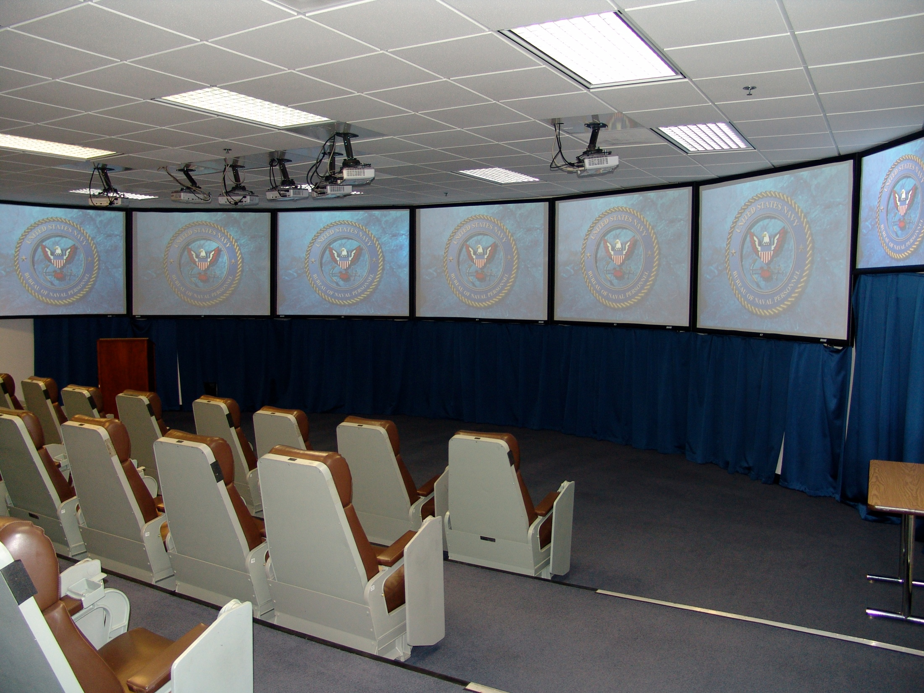
Notes:
This is a view of the infamous “tank”. There are three tanks in the selection board spaces. The members sit in ready room type chairs. You will notice five screens visible to the members. In most cases the first screen on the far left will have the PSR cover page which provides general background information on an eligible such as name, rate, education, last three duty stations, etc. On the other screens, PSR detail pages are shown which have a line entry summarizing every eval an applicant has had in his/her career.
The member who reviewed the applicant’s record in the board room starts to brief, members start to vote using their handset, when the last member has voted the votes are tabulated and the number of yes votes and the computed confidence factor is entered into the computer vote file and is simultaneously displayed on the two computer monitors at the front of the room.

Slide 21
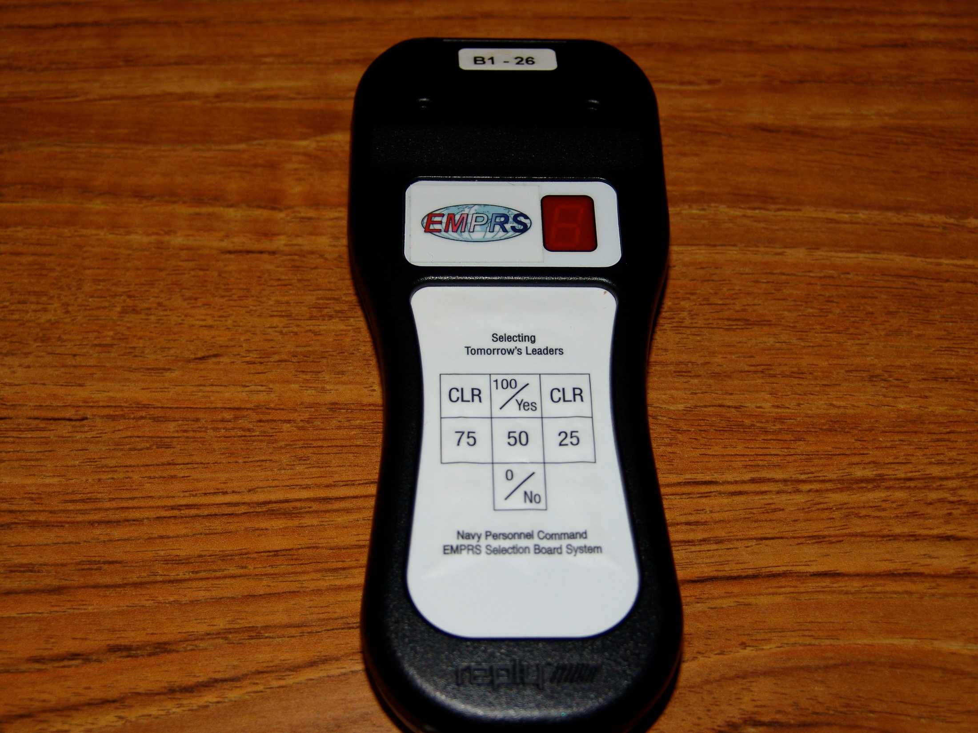
Notes:
This is the voting box that members use in the tank. Board members vote their confidence in the applicant’s ability to perform as an LDO/CWO at 100, 75, 50, 25, or 0.

Slide 22
Board Process Overview
  Once all records have been briefed and voted, a scattergram is displayed that shows a cumulative number of votes at each confidence level
  The floor is open for motions
    Tentatively select those applicants that are clearly at the top
    Drop from further consideration those applicants that are clearly not competitive for further consideration
  Those applicants who remain after those tentatively selected or dropped from further consideration are considered “crunch” records and are briefed and voted again
  NOTE: This is an overview of typical motions made by a board membership and is not meant to represent an actual tank voting session
Notes:
What can be made public of the board process is reflected in this section.

Slide 23
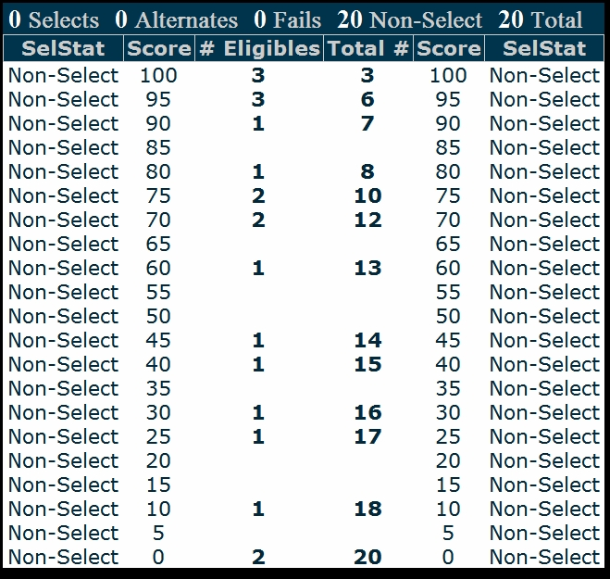
Scattergram
To select 10
Notes:
This is an example of a scattergram prior to any voting motions.
The scattergram allows members to see the results of a vote session, so that the relative scores of applicants may be considered. In this example of 20 records, and assuming a selection rate of 50%, one might see discussion of simply selecting the top 10 records, or of selecting perhaps the top 7 records, while removing the bottom 7 records from further consideration. Once the members have discussed the topic, a member will make a voting motion.

Slide 24
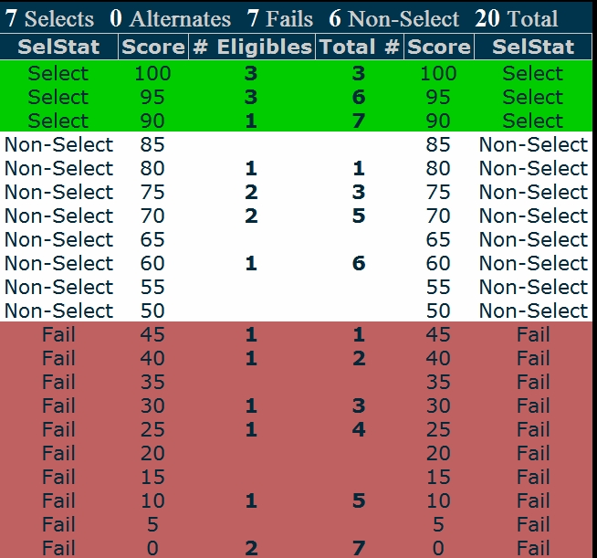
Scattergram
Tentatively
Select 90 and above
Crunch 6
to select 3
Drop From Further Consideration 45 and below
To select 10
Notes:
Once a voting motion has been seconded, a majority vote is taken. In this example, if the motion is approved, the board will “crunch” 6 records to tentatively select a maximum of 3 additional applicants, which would be 10 tentative selects. The records which are neither removed from consideration, nor tentatively selected, are commonly referred to as crunch records. They are briefed again and go through the same scattergram and voting process. This process continues until the board has selected the number of applicants authorized or until the board determines that no further applicants are qualified for commissioning.

Slide 25
Board Process Overview
  When all designators have been to the tank, the board is
  complete.
    Board members and recorders sign certifying that
      The board complied with all instructions
      Each applicant was properly considered
      The applicants recommended for selection are best qualified to meet the needs of the Navy
    Board members are briefed on confidentiality
    The Board President adjourns the board

Slide 26
Board Member Confidentiality
  Sample items board members cannot discuss
    Recommended selectees prior to results being made public
    Why an applicant was or was not selected
    Items they saw in a applicant’s record
    Score sheet categories or point values
    Period of review
    How a cut line is established
    Which applicants are briefed in the tank
    The items briefed in the tank
    Method used in determining selections
Board members may NEVER disclose the proceedings and deliberations of any board.
Notes:
The safest way to preserve the integrity of the board process in providing career guidance to candidates on selection board matters is via career development boards after the results are made public, not one-on-one discussions between board members and applicants.
Note to briefer: When board members are providing selection board briefs, refrain from using the term “we” as in what they and their panel or the board did, considered, etc.

Slide 27
Post Board Process
  Selects are reviewed for adverse matter
    Those placed on hold are notified of their selection by their command, who then provides requested information to CNP (via NPC) who will decide whether to release the hold or permanently remove the selection
    Holds may take six weeks to a year or more to resolve
  PERS 804 prepares the board’s record of proceedings (ROP)
    Routed to CNP via PERS 80, DCNPC, CNPC Legal, and CNPC
  CNP approves the results and releases results via NAVADMIN
Notes:
Those placed on hold are not announced on the NAVADMIN. Common reasons for holds are recent disciplinary action and security clearance problems.

Slide 28
Common Issues
  Post-board scrub
    Security clearance issues, NJPs, DFC, pending investigations
    Results in candidates on hold and missing from the NAVADMIN
  Candidates do not complete commissioning physical early and are found not medically qualified to commission
    Result: Candidate placed in abeyance, results in fleet manning gap – sometimes up to a year or longer
  Adverse event occurs. Command documents locally but fails to report that info to PERS 803
    Result: Candidate gets commissioned
  NPC assumes all is good unless notified otherwise. COMMUNICATION BETWEEN COMMANDS AND PERS 803 IS KEY!

Slide 29
FAQs
  1. How is PRIMS used in the selection board process?
    It is not.
  How is NSIPS ESR data used in the selection board process?
    Only if contained in the OMPF or included in the application.
  3. How far back in the record does the board consider?
    The entire record is available for review.
  How are alternates identified?
    Alternates are selected as alternates during the tank sessions. If a select falls out, an alternate will be notified by letter from NPC via their CO.

Slide 30
Myths
  A member of the board who knows you increases your chances for
  selection. FALSE
  2. The selection board only considered items in my OMPF, PSR, and items in
  my application and any addendums. TRUE
  3. The selection board accepts items from both me and my command up to the convening of the board. FALSE (x2). Items are accepted only from applicants and only up to the deadline in the announcing NAVADMIN.
  Application status is posted on BOL. TRUE; however, addendum receipt is not.
  E6 candidates do not need to take the E7 exam if on an IA in theater. FALSE. See NAVADMIN 336/07 paragraphs 3 and 8.
  6. Only adverse information contained in my OMPF can be considered by the
  board. TRUE, unless submitted in the candidate’s application.

