Slide 1

Nuclear Power LDO (6200)
Unclassified

Slide 2
Nuclear Power LDO
LDO and CWO Mission
The Limited Duty Officer and Chief Warrant Officer Community support the war-fighting capability and readiness of Naval Forces through leadership, technical proficiency, and experience.
We are the primary manpower source for technically specific billets not best suited for traditional Unrestricted Line, Restricted Line, or Staff Corps career path Officers. Using critical enlisted experience, we are committed to the continuous leadership, improvement, training and mentoring of Sailors.
Nuclear Power and Maintenance Technical Experts

Slide 3
Nuclear Power LDO
Program
Are you the go-to Sailor when a solution is needed?
Does the chain of command actively seek your input?
Are you the supervisor for important evolutions?
Are you the one that tells people to wait while you check the references?
Are you comfortable working beyond your rate?
IF YOU ANSWERED YES TO SOME OR ALL OF THE ABOVE, YOU ARE THE TYPE OF PERSON WE WANT AS A NUCLEAR POWER LDO.
Technical Experts Joining Wardrooms

Slide 4
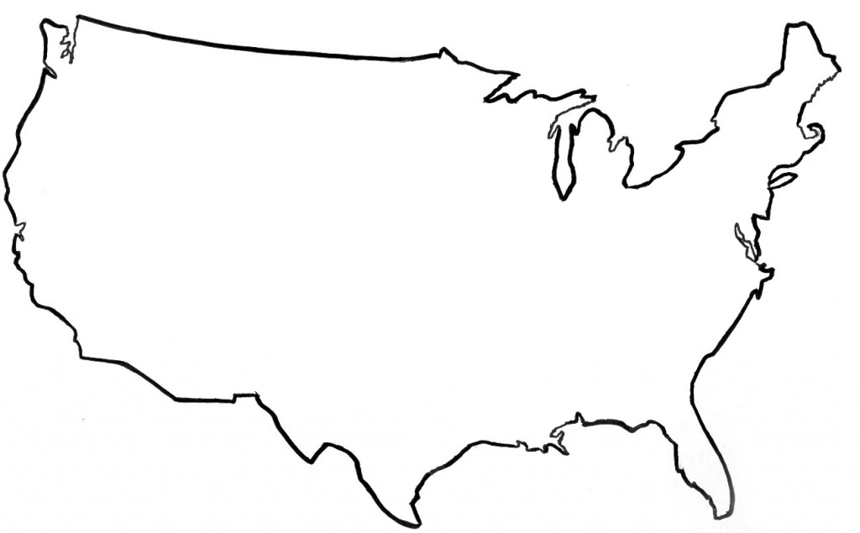


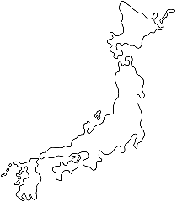

Nuclear Power LDO
Program
Puget Sound
PSNSY
TRF
TTF
COMSUBRON
NR Field Office
CVN
SSBN
SSN
District of Columbia
NR Headquarters
Chief of Naval Personnel
Portsmouth
NR Field Office
PNSY
SSN
New York
KAPL & West Milton Laboratory Field Offices
NPTU
Groton
NSSF
SSN/PCU
NR Field Office
Historic Ship
Idaho
Naval Research Facility Idaho
Pittsburgh
Bettis & ANSTR Laboratory Field Offices
Hampton Roads
CVN/PCU
NNSY
SSN/PCU
NR Field Offices (x2)
COMSUBFOR
CNAL
Millington
Naval Personnel Command
Pearl Harbor
PHNSY
COMSUBPAC
COMSUBRON
NR Field Office
SSN
San Diego
CNAF
COMSUBRON
CVN
NR Field Office
SWRMC
SSN
Dry Dock
Charleston
NFAS
NPTU
NR Field Office
Kings Bay
TRF
COMSUBRON
SSBN
NR Field Office
Guam
Submarine Tenders
COMSUBRON
NR Field Office
Japan
CVN
NR Field Office
COMSUBGRU
Italy
COMSUBGRU
Duty Stations Available Around the World

Slide 5
Nuclear Power LDO
Career Path - Fleet
36 Month Tour Lengths
Assignments
Maintenance Facility Command
DEPUTY SY CMDR
CVN CHIEF ENGINEER
MAJOR PMA, OCM, IMA XO, SUB Base XO, NFAS DIRECTOR
PMA, TYCOM STAFF, IMA PA, MISC REPAIR, FORCE RADCON ASST
CVN/AS PRINCIPAL ASSISTANT (CRA,RMA/REA,RMO,SMM, ELECTRO, PMA, RCO)
IMA DIVO, TYCOM, SY PROJ SUPT, DRYDOCK XO, PCU/SOC, NPC
CVN TA, TENDER, SSN PCU, Submarine Overhaul Coord
CVN TA, TENDER, NPTU ASE
Major Command
23 YCS
Maintenance Leadership
20 YCS
CAPT
Pinnacle Position: CVN CHENG
17 YCS
Must
do
CVN PA to be CVN CHENG
CDR
Senior LCDRs/junior CDRs have opportunity for PMA or equivalent maintenance leadership positions
14 YCS
11 YCS
LCDR
4th Tour: CVN/AS PA*
8 YCS
Must
do
CVN TA to be CVN PA
LT
3rd Tour: Elective Tour
5 YCS
LTJG
2nd Tour: Repair/Maintenance
3 YCS
ENS
1st Tour for most LDOs: CVN TA*
0 YCS
Normally*
Milestone Tours
Career Flexibility to Meet Milestones & Life

Slide 6
Nuclear Power LDO
JO Career Path - Fleet
36 Month Tour Lengths
Assignments
CVN/AS PRINCIPAL ASSISTANT (CRA,RMA/REA,RMO,SMM, ELECTRO, PMA, RCO)
IMA DIVO, TYCOM, SY PROJ SUPT, DRYDOCK XO, PCU/SOC, NPC
CVN TA, TENDER, SSN PCU, Submarine Overhaul Coord
CVN TA, TENDER, NPTU ASE
CAPT
CDR
LCDR
4th Tour: CVN/AS PA*
8 YCS
Must
do
CVN TA to be CVN PA
LT
3rd Tour: Elective Tour
5 YCS
LTJG
2nd Tour: Repair/Maintenance
3 YCS
ENS
1st Tour for most LDOs: CVN TA*
0 YCS
Normally*
Milestone Tours
Career Flexibility to Meet Milestones & Life

Slide 7
Nuclear Power LDO
Career Path – Naval Reactors
Assignments
Senior Leadership (Upper Half) Deputy NRR, NR HQ Staff Overall Projects Lead
Senior Leadership (Lower half) CVN Overhaul Lead Reactor Servicing Lead CVN Projects Lead Submarine Projects Lead ANRR Kings Bay/San Diego/Guam
Lead Position Radcon Lead JTG/Testing Lead JRG/Refueling Lead QA Lead
Large Project Lead (ERO, EOH, RCOH, PIA, DPIA, etc)
Small Project Lead (SRA, CMA)
Qualification Tour
21 YCS
CAPT
Senior Leadership Positions
Milestone Position: ANRR
15 YCS
CDR
4th Assignment: Senior Leadership Positions (Lower Half)
Senior LCDRs/junior CDRs have opportunity for leadership positions as ANRR
10 YCS
LCDR
3rd Assignment: Lead Positions
4 YCS
LT
2nd Assignment: Large Project Lead
LTJG
1st Assignment: Qualification Tour, followed by Small Project Lead
2 YCS
0 YCS
ENS
60 Month Tour Lengths (Nominally)
Longer Tours for Better Stability

Slide 8
LDO Designators
Line (SURFACE)
611X DECK
612X OPERATIONS
613X ENGINEERING/REPAIR
618X ELECTRONICS
Line (SUB / NUCLEAR)
6200 NUCLEAR POWER (NAVADMIN 006/16)
623X ENGINEERING/REPAIR
626X ORDNANCE
628X ELECTRONICS
*629X COMMUNICATIONS
Line (AVIATION)
631X DECK
633X MAINTENANCE
636X ORDNANCE
639X AIR TRAFFIC CONTROL
General Line
641X ADMINISTRATION
643X BANDMASTER
648X EXPLOSIVE ORDNANCE DISPOSAL
649X SECURITY
Staff
*651X SUPPLY CORPS
653X CIVIL ENGINEER CORPS
* Applicants for LDO off-ramp designators must comprehend designator specific off-ramp requirements and procedures as defined in NAVADMIN 128/19 (629X) or NAVADMIN 014/18 (651X)
LT at 5 years for Supply to core Staff designator
LT at 4-6 years for Sub Communications to core Restricted Line
Must have completed a baccalaureate degree
Must have appropriate Warfare device

Slide 9
Guidance and
Eligibility Checklist

Slide 10
FY-26 Accession Windows
Time in Service (TIS) windows (Computed to 01OCT25)
  8 to 16 years for Nuclear LDO [01OCT 17 – 01OCT 09]
  Importance of TIS waivers:
    THEY DO NOT EXIST. 16 years is a hard cutoff for nuclear applicants.
Notes:
Changes in accession windows will:
Create a more predictable inventory for career progression
Provides time for all LDOs to compete for Captain and all CWOs to compete for CWO4 (most for CWO5)
Minimizes “early” selections from “clogging” the promotion pipeline

Slide 11
FY-26 Guidance
Am I eligible to take the CPO Exam for LDO purposes?
BLUF: Yes, provided:
1. You are a First Class Petty Officer (A Sailor who advances to First Class Petty Officer off the 2023 March Exam, is eligible to take the 2024 January CPO Exam for LDO purposes)
2. Have command endorsement and approval.
A Sailor who advances to First Class Petty Officer off the 2023 September exam, is not eligible to apply for the upcoming LDO/CWO ISP Board and should not be recommended to participate in the immediate upcoming 2024 January CPO Exam for LDO Purposes.

Slide 12
FY-26 Guidance
Review ACTIVE DUTY LIMITED DUTY OFFICER, CHIEF WARRANT OFFICER AND WARRANT OFFICER PROGRAMS OPNAVINST 1420.2 (update 3Apr2024)
Applicable NAVADMINs supersede conflicts with OPNAVINST 1420.2
Use FY-26 Active Nuclear LDO ISP Board NAVADMIN 105/24 for application guidance and deadlines
  First Class Petty Officers awaiting CPO results, who meet all other requirements, are encouraged to apply and submit their application by the 1 OCT 2024 deadline.

Slide 13
Applicant Preparation
  Never too early to start preparing – even as an E4
Make your chain of command aware of your goals
  Develop a strong resume with diversity of jobs
  Excel in your Rating Specialty
    Evaluations – Breakouts / Superior performance aligned with discrete requirements
Sea duty, Shore duty, Overseas, Special Programs, Warfare
Qual(s), Watch Station Qual(s)/Certifications
Successful LPO or LCPO tours
Work with an LDO/CWO Mentor to help you through the process
    Maximize your opportunities!
    (Master your craft)
DOES YOUR RECORD STACK UP?
13
Notes:
These are listed in order of relevance to typical board weighting. Must have good evals, soft breakouts …

Slide 14
Be Truthful to Yourself!!
(The LDO program NEEDS the most reliable people!)
PERS-422
Consider these questions of yourself: because we will…
  Do you value people of all backgrounds and realize their importance as our greatest asset?
  Does the chain of command seek your input? Are you that go-to Sailor?
  Are you the supervisor for important evolutions?
  Do you tell people to wait while you check the references?
  Do you speak up when you see something wrong?
  Are you comfortable working beyond your rate?
  Are you worldwide assignable? Does your family know what that means?
Have you actually discussed this program with your family?

Slide 15
Application
Key Elements
CO’s Endorsement
  Acknowledges your leadership potential and technical performance
  Can highlight qualifications (utilizing the discrete requirements)
  Can address past negatives (if needed) and waivers if applicable
  Ranking no longer required or desired
Additional Comments
  Your opportunity to speak directly to the board about your record
    Address absent discrete requirements, qualifications, broken service, etc.
    Address waivers (required waivers must be approved prior to submission)
  Limit to 100 words – simply stating “None” works – do not feel compelled to fill the white space
  NOTE: This is NOT a personal statement, as required in past years
Notes:
12
12
CO’s must control Interview Appraisal Board process and establish and appoint board members or a command coordinator that ensures Interview Appraisals are not hand-picked by member. Interview boards must provide honest feedback to the member and to the CO on member’s qualifications and abilities as outlined per the instruction. If not ready, then DO NOT recommend at the command level, don’t leave this up to the board to filter out. Highlight accomplishments and qualifications here. Read the precepts from past boards (online). If there is any issue that needs to be brought to the boards attention, this is the best place to address it.

Slide 16
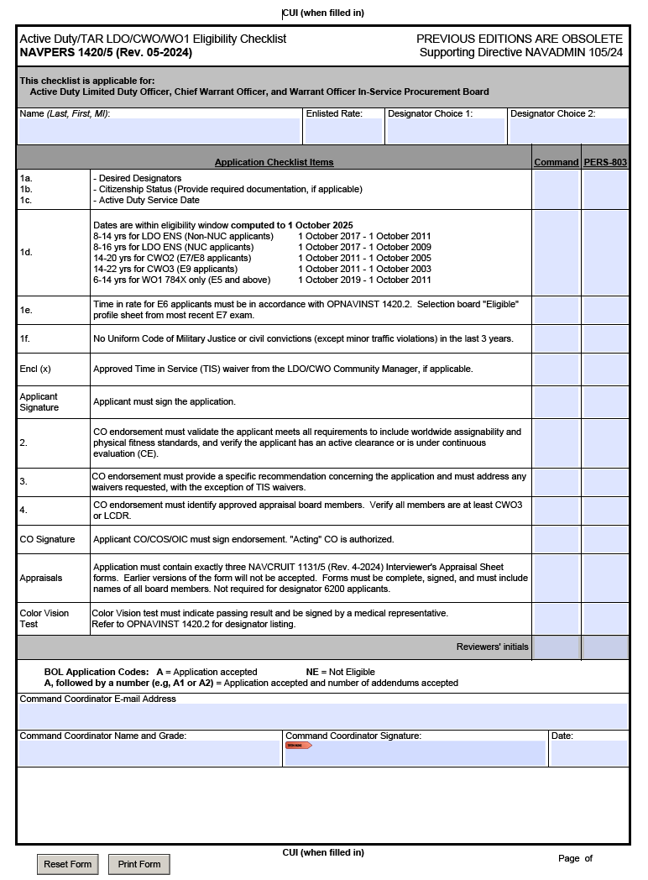
FY-26 LDO Programs
Eligibility Checklist
FY-24/25 Errors
Some applications had more than one error and several applicants did not meet eligibility requirements for submission
Using the wrong NAVADMIN in your application letter and CO’s endorsement
CO’s Endorsement references wrong date for application letter
CO’s Endorsement – Not included, not signed, or missing references requirement (“meets all requirements outlined in references (a) through (c).”)
Citizenship – Not filled out or missing documentation proof of citizenship
Missing Security Clearance information
Errors should be caught prior to their arrival at NPC. A well versed command LDO coordinator can provide assistance to both the command and the candidate during the application process.
SAMPLE
FY-26 CHECKLIST FROM MYNAVYHR

Slide 17
Notional Application Timeline
MAR: Special Request to CO via Command Coordinator
May/JUN: Submit application to Admin
JUL/AUG: CO’s endorsement prepared
SEP: Submit applications
NLT 01 OCT: Applications due to NPC
NLT 15 DEC: Addendums (Evals, Awards, etc.) due to NPC
FEB: Board convenes
FEB/MAR: Results announced via NAVADMIN
Command Coordinator/Admin shall provide a copy of the entire completed/signed application with ALL enclosures to the applicant. This can be accomplished via paper copy or by carbon copy (cc) during electronic submission.

Slide 18
FY-25 Active Duty Selections
Active Duty Quotas Selected Announced
Enlisted to ENS (LDO) 42 42 42
Total applications for FY-25 LDO: 162
Selection Opportunity LDO: 26%

Slide 19





Nuclear Power LDO
Promotion Opportunity
CAPT 21 - 23 YCS 40 - 60% Opportunity
CDR 15 - 17 YCS 60 - 80% Opportunity
LCDR 9 - 11 YCS 70 - 90% Opportunity
LT 4 YCS AFQ
LTJG 2 YCS AFQ
Increased Promotion Opportunity
19
Notes:
20

Slide 20
Nuclear Power LDO
Retirement
20 Years of Service:
50% (40%)
CPO
$2,879 / month
$34,547 / year
LT
$4,430 / month
$53,154 / year
26 Years of Service:
65% (52%)
SCPO
$4,732 / month
$56,871 / year
LCDR
$6,298 / month
$75,575 / year
30 Years of Service:
75% (60%)
MCPO
$6,728 / month
$80,733 / year
LCDR
$7,267 / month
$87,202 / year
DISCLAIMER: High Three Pay before taxes / BRS CALCULATED +2% per year over 20 (Does not consider members/GOVT contributions to BRS/TSp)
http://militarypay.defense.gov/Calculators/High-3-Calculator/

Slide 21
Nuclear Power LDO
Retirement
35 Years:
87.5% (70%)
CDR
$9,998 / month
$119,980 / year
38 Years:
95% (76%)
CAPT
$13,568 / month
$162,819 / year
DISCLAIMER: High Three Pay before taxes / BRS CALCULATED +2% per year over 20 (Does not consider members/GOVT contributions to BRS/TSp)
http://militarypay.defense.gov/Calculators/High-3-Calculator/

Slide 22
Nuclear Power LDO
Application Requirements
https://www.mynavyhr.navy.mil/Career-Management/Community-Management/Officer/Active-OCM/LDO-CWO/Applicant-Information/
Required to be qualified EWS / PPWS. NEC N33Z must be updated in record (See Detailer)
Chiefs, Senior Chiefs, Master Chiefs, or CPO Board eligible E6
  may take CPO exam 1 year early to apply for LDO
8 – 16 years time in service
  Based off of date in associated application year NAVADMIN
  FY-26 NAVADMIN 105/24
Application Deadline: 01 OCT 24
10 year commitment
NAVADMIN supersedes other guidance

Slide 23
FY-25 Selectee Profile (LDO/CWO)
“YOUR COMPETITION” (6200 Specific)
Average Age: 30
Total Years of Active Service: 11.5 years (11.8 – 10yr avg)
Average Years of Total Education Completed: 14 years
Warfare Qualified: 100%
Average Number of Duty Stations: 2.5 (non-training pipeline)
Average Number of Sea / Overseas Tours: 1

