Slide 1



Submarine-specific
LDO/CWO Applicant Brief
https://www.mynavyhr.navy.mil/Career-Management/Community-Management/Officer/Active-OCM/LDO-CWO/Applicant-Information/

Slide 2
Topics
LDO and CWO Mission
LDO and CWO Definition
62xx/72xx Designators
Discrete Requirements
Guidance and Eligibility Checklist
Application Preparation
FY-25 Board statistics
Promotion Opportunity
Return on Investment (ROI)

Slide 3
LDO and CWO Mission
The Limited Duty Officer and Chief Warrant Officer Community supports the war-fighting capability and readiness of Naval Forces through leadership, technical proficiency, and experience.
We are the primary manpower source for technically specific billets not best suited for traditional Unrestricted Line, Restricted Line or Staff Corps career path Officers. Using critical enlisted experience, we are committed to the continuous leadership, improvement, training and mentoring of Sailors.

Slide 4
Limited Duty Officer (LDO)
Technical Managers – LDOs are Naval Line or Staff Corps Officers that progressively advance within broad technical fields related to their former enlisted ratings
LDOs fill leadership and management positions at the ENS through CAPT level that require technical background and skills not attainable through normal development within other officer designators
LDOs serve as, but are not limited to, DIVOs, DEPT Heads, OICs, XOs and COs
Major Command (CAPT level) is the pinnacle goal – only achieved by a few!

Slide 5
LDO Designators
Line (SURFACE)
611X DECK
612X OPERATIONS
613X ENGINEERING/REPAIR
618X ELECTRONICS
Line (SUB / NUCLEAR)
6200 NUCLEAR POWER (NAVADMIN 006/16)
623X ENGINEERING/REPAIR
626X ORDNANCE
628X ELECTRONICS
*629X COMMUNICATIONS
Line (AVIATION)
631X DECK
633X MAINTENANCE
636X ORDNANCE
639X AIR TRAFFIC CONTROL
General Line
641X ADMINISTRATION
643X BANDMASTER
648X EXPLOSIVE ORDNANCE DISPOSAL
649X SECURITY
Staff
*651X SUPPLY CORPS
653X CIVIL ENGINEER CORPS
* Applicants for LDO off-ramp designators must comprehend designator specific off-ramp requirements and procedures as defined in NAVADMIN 128/19 (629X) or NAVADMIN 014/18 (651X)
LT at 5 years for Supply to core Staff designator
LT at 4-6 years for Sub Communications to core Restricted Line
Must have completed a baccalaureate degree
Must have appropriate Warfare device

Slide 6
Chief Warrant Officer (CWO)
Technical Specialist - CWOs are Naval Officers that possess extensive experience and knowledge to direct the most difficult and exacting operations within a given occupational specialty
Although intended primarily as technical specialists, CWOs can also serve as DIVOs, DEPT Heads or OICs
CWO assignments are “REPETITIVE” in nature
Chiefs (including Frocked) and Senior Chiefs commission to CWO2
Master Chiefs (including Frocked) commission to CWO3

Slide 7
CWO Designators
Line (SURFACE)
711X BOATSWAIN
712X OPERATIONS TECHNICIAN
713X ENGINEERING/REPAIR TECHNICIAN
715X* SPECIAL WARFARE TECHNICIAN
  Core
  Undersea
717X NAVAL SPECIAL WARFARE COMBAT CREWMAN
718X ELECTRONICS TECHNICIAN
Line (SUB / NUCLEAR)
720X DIVING OFFICER
726X ORDNANCE TECHNICIAN
728X ACOUSTIC TECHNICIAN
Line (AVIATION)
731X BOATSWAIN
732X OPERATIONS TECHNICIAN
733X MAINTENANCE TECHNICIAN
736X ORDNANCE TECHNICIAN
Line (AVIATION UNMANNED AIRCRAFT)
737X AERIAL VEHICLE OPERATOR (OCS WO1)
Line (GENERAL / STAFF)
741X SHIP’S CLERK
752X FOOD SERVICE WARRANT
749X SECURITY TECHNICIAN
Line (INFO Warfare Community)
780X OCEANOGRAPHY WARRANT
781X CRYPTOLOGIC WARFARE TECHNICIAN
782X INFORMATION SYSTEMS TECHNICIAN
783X* INTELLIGENCE TECHNICIAN
  CI/HUMINT
  GEOINT/Targeting
  OPINTEL
784X CYBER WARRANT (WO1 Only)
* Special Warfare (715X) and Intelligence (783X) CWO applicants will be considered for selection into Core Competency Areas (CCA)

Slide 8
Be Truthful to Yourself!!
(The LDO/CWO program NEEDS the most reliable people!)
PERS-422
Consider these questions of yourself: because we will.
Why do you want to be an Officer?
Is the LDO/CWO Program the right career choice for me?
Do you value people of all backgrounds and realize their importance as our greatest asset?
Does the chain of command seek your input? Are you the go-to Sailor?
Are you the supervisor for important evolutions?
Do you tell people to wait while you check the references?
Do you speak up when you see something wrong?
Are you comfortable working beyond your rate?
Are you worldwide assignable? Does your family know what that means?
Have you actually discussed this program with your family?

Slide 9
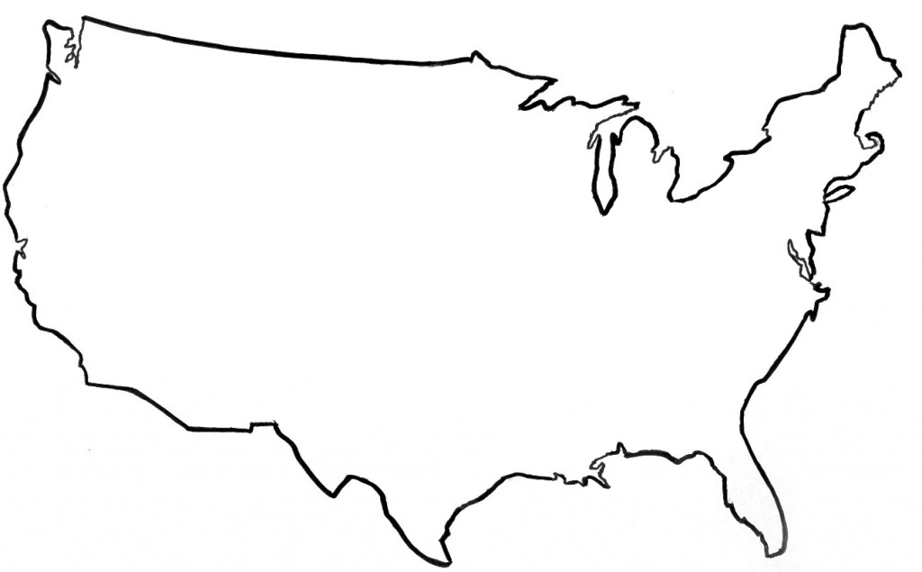


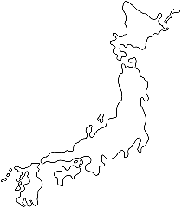

Nuclear Power LDO
Program
Puget Sound
PSNSY
TRF
TTF
COMSUBRON
NR Field Office
CVN
SSBN
SSN
District of Columbia
NR Headquarters
Chief of Naval Personnel
Portsmouth
NR Field Office
PNSY
SSN
New York
KAPL & West Milton Laboratory Field Offices
NPTU
Groton
NSSF
SSN/PCU
NR Field Office
Historic Ship
Idaho
Naval Research Facility Idaho
Pittsburgh
Bettis & ANSTR Laboratory Field Offices
Hampton Roads
CVN/PCU
NNSY
SSN/PCU
NR Field Offices (x2)
COMSUBFOR
CNAL
Millington
Naval Personnel Command
Pearl Harbor
PHNSY
COMSUBPAC
COMSUBRON
NR Field Office
SSN
San Diego
CNAF
COMSUBRON
CVN
NR Field Office
SWRMC
SSN
Dry Dock
Charleston
NFAS
NPTU
NR Field Office
Kings Bay
TRF
COMSUBRON
SSBN
NR Field Office
Guam
Submarine Tenders
COMSUBRON
NR Field Office
Japan
CVN
NR Field Office
COMSUBGRU
Italy
COMSUBGRU
Duty Stations Available Around the World

Slide 10
Nuclear Power LDO
Career Path - Fleet
36 Month Tour Lengths
Assignments
Maintenance Facility Command
DEPUTY SY CMDR
CVN CHIEF ENGINEER
MAJOR PMA, OCM, IMA XO, SUB Base XO, NFAS DIRECTOR
PMA, TYCOM STAFF, IMA PA, MISC REPAIR, FORCE RADCON ASST
CVN/AS PRINCIPAL ASSISTANT (CRA,RMA/REA,RMO,SMM, ELECTRO, PMA, RCO)
IMA DIVO, TYCOM, SY PROJ SUPT, DRYDOCK XO, PCU/SOC, NPC
CVN TA, TENDER, SSN PCU, Submarine Overhaul Coord
CVN TA, TENDER, NPTU ASE
Major Command
23 YCS
Maintenance Leadership
20 YCS
CAPT
Pinnacle Position: CVN CHENG
17 YCS
Must
do
CVN PA to be CVN CHENG
CDR
Senior LCDRs/junior CDRs have opportunity for PMA or equivalent maintenance leadership positions
14 YCS
11 YCS
LCDR
4th Tour: CVN/AS PA*
8 YCS
Must
do
CVN TA to be CVN PA
LT
3rd Tour: Elective Tour
5 YCS
LTJG
2nd Tour: Repair/Maintenance
3 YCS
ENS
1st Tour for most LDOs: CVN TA*
0 YCS
Normally*
Milestone Tours
Career Flexibility to Meet Milestones & Life

Slide 11
Nuclear Power LDO
JO Career Path - Fleet
36 Month Tour Lengths
Assignments
CVN/AS PRINCIPAL ASSISTANT (CRA,RMA/REA,RMO,SMM, ELECTRO, PMA, RCO)
IMA DIVO, TYCOM, SY PROJ SUPT, DRYDOCK XO, PCU/SOC, NPC
CVN TA, TENDER, SSN PCU, Submarine Overhaul Coord
CVN TA, TENDER, NPTU ASE
CAPT
CDR
LCDR
4th Tour: CVN/AS PA*
8 YCS
Must
do
CVN TA to be CVN PA
LT
3rd Tour: Elective Tour
5 YCS
LTJG
2nd Tour: Repair/Maintenance
3 YCS
ENS
1st Tour for most LDOs: CVN TA*
0 YCS
Normally*
Milestone Tours
Career Flexibility to Meet Milestones & Life

Slide 12
Nuclear Power LDO
Career Path – Naval Reactors
Assignments
Senior Leadership (Upper Half) Deputy NRR, NR HQ Staff Overall Projects Lead
Senior Leadership (Lower half) CVN Overhaul Lead Reactor Servicing Lead CVN Projects Lead Submarine Projects Lead ANRR Kings Bay/San Diego/Guam
Lead Position Radcon Lead JTG/Testing Lead JRG/Refueling Lead QA Lead
Large Project Lead (ERO, EOH, RCOH, PIA, DPIA, etc)
Small Project Lead (SRA, CMA)
Qualification Tour
21 YCS
CAPT
Senior Leadership Positions
Milestone Position: ANRR
15 YCS
CDR
4th Assignment: Senior Leadership Positions (Lower Half)
Senior LCDRs/junior CDRs have opportunity for leadership positions as ANRR
10 YCS
LCDR
3rd Assignment: Lead Positions
4 YCS
LT
2nd Assignment: Large Project Lead
LTJG
1st Assignment: Qualification Tour, followed by Small Project Lead
2 YCS
0 YCS
ENS
60 Month Tour Lengths (Nominally)
Longer Tours for Better Stability

Slide 13
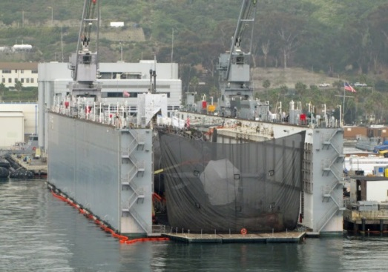
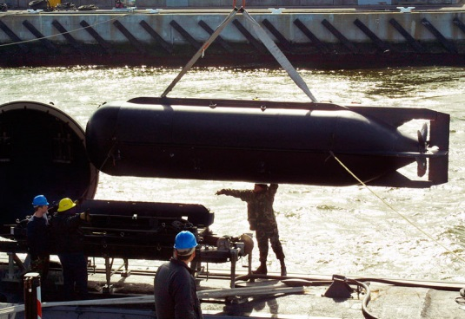
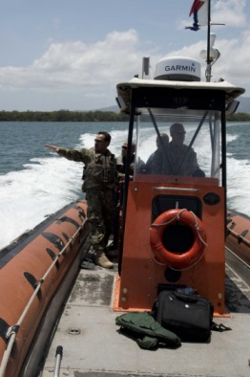
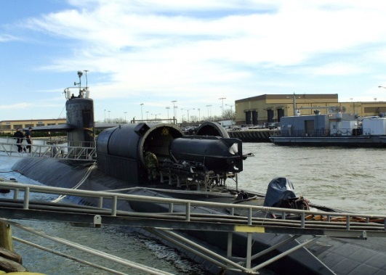
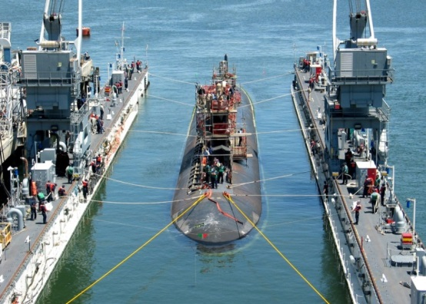
6230: Submarine Engineering
PERS-422
Technical managers in marine engineering, including operations, maintenance and repair of main propulsion, auxiliary machinery and systems.
Source Enlisted Rating: Submarine MMA, ND, HT

Slide 14
6230: Submarine Engineering
PERS-422
Assignments
CNSWC
NAVAL SPECWAR LOGSU XO; NAVAL SPECWAR REPAIR; JBPHH CSO
DRY-DOCK CO; NAVAL SPECWAR ASST REPAIR NAVAL SPECWAR LOGSU RO; OIC NAVSEA PMS 394; CSL; NAVAL SAFETY CENTER; NAVAL BASE OPS OFF
NAVAL SPECWAR QAO; NAVAL SPECWAR DET AOIC;
DRY-DOCK/IMA DOCKING OFFICER; SWRMC/NSY REPAIR OFF; PORT SERVICES; AS REPAIR OFF
DDS/SDV MAINT OFF; NRD, Repair
CNSWC
23 YCS
CAPT
21 YCS
NSWG-8 OIC, XO Ashore
18 YCS
CDR
15 YCS
LOGSU XO, SPECWAR RO
Maintenance leadership positions in various SPECWAR and sub locations
12 YCS
9 YCS
LCDR
4th Tour: SPECWAR or staff repair
6 YCS
3rd Tour: Repair/Maint
LT
LTJG
2nd Tour: Port OPS, Docking, SPECWAR
3 YCS
0 YCS
ENS
1st Tour: DO afloat/ashore
36 Month Tour Lengths

Slide 15
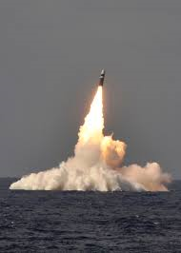
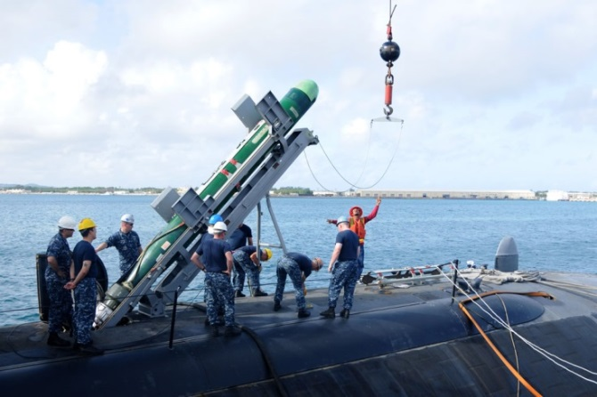
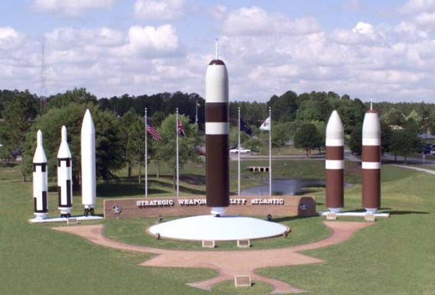
6260 / 7261: Submarine Ordnance
PERS-422
Strategic weapons and conventional ordnance technical managers
Source Enlisted Ratings: MT, TM, FT

Slide 16
6260: Submarine Ordnance
PERS-422
Assignments
USFF COMMAND; COMPACFLT; DIRSSP WASHINGTON DC
OPNAV STAFF; USFF COMMAND; COMPACFLT, DIRSSP WASHINGTON DC
NUWC OIC; XO NMC EAST ASIA DIV SWFPAC/SWFLANT XO; OIC NWID; COMSUBLANT/COMSUBPAC
XO NMC EAST ASIA DIV; COMSUBLANT/COMSUBPAC; SWFPAC/SWFLANT WEPS; OIC NWID
SSP PROGRAM SUPT; SPECIAL PROJECTS/OIC; SUBMARINE TENDER; CMBT SYS SUPT; NAVORDTESTU;
SSBN WEP FBM; COMSUBRON (SSN); SWFPAC; SWFLANT;
SUBMARINE TENDER; SSBN AWEP; SWFPAC; SWFLANT;RECRUITING
23 YCS
DIRSSP, Chief NW Inspector
21 YCS
CAPT
XO/OIC Ashore
18 YCS
Senior LCDRs/junior CDRs have opportunity for various OIC/XO Ashore, SWF WEPS
15 YCS
CDR
12 YCS
9 YCS
LCDR
4th Tour: SSBN WEPS, AS WEPS
3rd Tour: SWF, CSS WEPS
6 YCS
LT
2nd Tour: AWEPS, SWF DO
3 YCS
LTJG
ENS
1st Tour: DO, NRD, AS DO
0 YCS
36 Month Tour Lengths

Slide 17
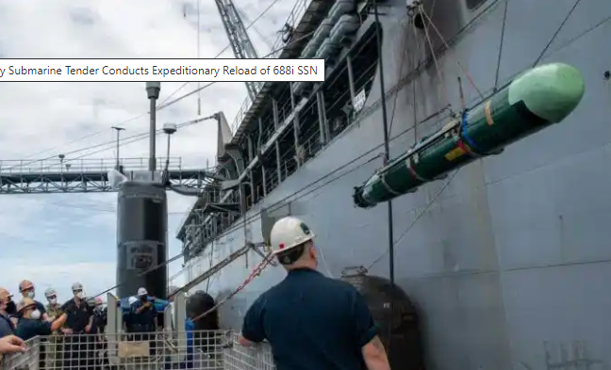
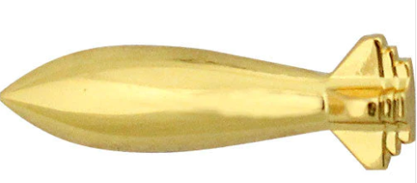
7261: Ordnance Technician
PERS-422
Assignments
NWID INSPECTOR
AWEPS (SSBN, AS), DIRSSP, TYCOM Staff
AWEPS (SSBN), Torpedo Officer, MIW, Weapons QA, SWF, Nuclear Compliance
Gunnery Officer (AS), SWF, Torpedo Facility,
USFF, PACFLT NWID
15 YCS
CWO5
11 YCS
4th Tour: TYCOM, DIRSSP
CWO4
7 YCS
3rd Tour: OTC, ATO, DTRA
CWO3
3 YCS
2nd Tour: SWF, SSBN, AS
0 YCS
CWO2
1st Tour : AS, Weapons Facility
36 Month Tour Lengths

Slide 18
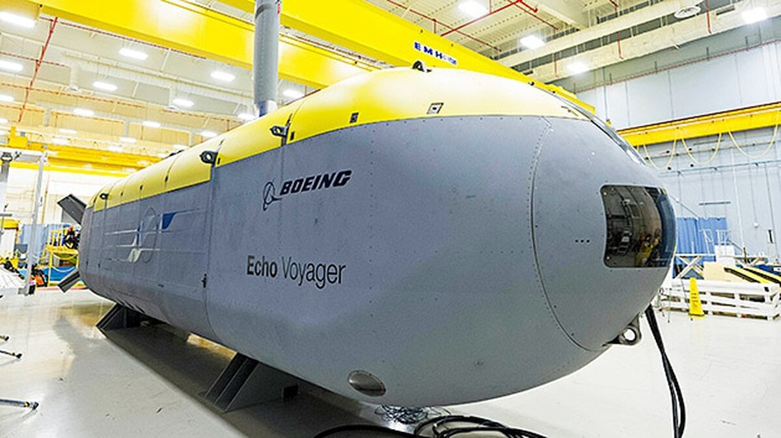

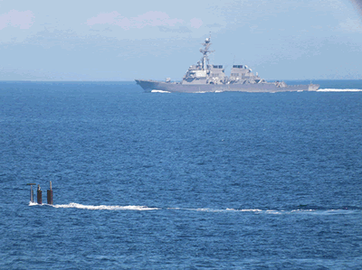


6280: Submarine Electronics
PERS-422
Technical managers in the field of non-nuclear electronics
Source Enlisted ratings: ETV, FT, STS

Slide 19
6280: Submarine Electronics
PERS-422
Assignments
OIC AFLOAT SPECIAL PROJECTS
SUBMARINE TENDER XO; XO SHORE ACT;
OIC ANDROS; CMBT SYS SUPT/REP; STF MTL C4I; OP T&E SUB ELECTRONICS SYSTEMS
SPECIAL PROJECTS/AT-SEA OIC; SHORE OIC;
SPECIAL PROJECTS/OIC; STF ELX/MTL OFF;
ELX INSTL/REP SSP PROGRAM SUPT; SPECIAL PROJECTS; TENDER
SPECIAL PROJECTS; TENDER; RECRUITING
NRL OIC
23 YCS
CAPT
AS XO, Base XO
21 YCS
Milestone Position: TYCOM Material, SP OIC
18 YCS
15 YCS
CDR
WPMA, Senior LCDRs/junior CDRs have opportunity for various OIC/XO for Special Projects and ashore
12 YCS
9 YCS
LCDR
4th Tour: CSS/SRS Material
6 YCS
3rd Tour: Special Projects
LT
LTJG
2nd Tour: Repair/Maint
3 YCS
0 YCS
ENS
1st Tour : DO, NRD, SP
36 Month Tour Lengths

Slide 20
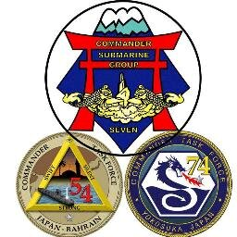
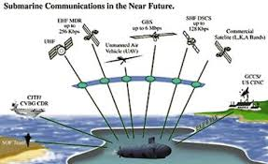


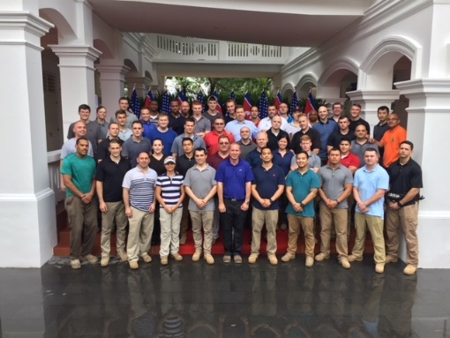
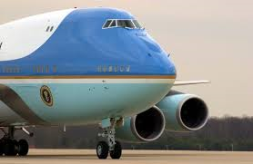

6290: Submarine Communications
PERS-422
Technical managers in the operation and application of techniques, equipment, and procedures in submarine communication.
Source Enlisted Ratings: ITS
Notes:
NAVADMIN 128/19
a. After two consecutive tours (4-6 years commissioned service), Submarine Communications (6290) LDOs will be eligible for redesignation to IP (1820) without board action. Reference (a), paragraph 4 provides detailed application procedures.
b. Beginning fiscal year 2020 (1 October 2019) approximately 38 submarine communications (6290) billets, lieutenant through captain, will be shifted to the IP (1820) designator. Current submarine communications (6290) LDOs may continue to compete for promotion in the nuclear and submarine competitive category, even though there will be zero control grade billets.
c. Reference (b) has been updated to include the additional qualification designator (AQD) IP officers qualified in submarine communications (SV3).
d. This NAVADMIN updates reference (c), adding the IP (1820) designator with AQD SV3 to the list of active-duty officers eligible for continuous submarine pay. Current submarine communications(6290) LDOs redesignated to IP (1820) will be paid following current guidelines for the submarine communications (6290) designator.
Reference (c) is currently under revision and will contain this update upon release.

Slide 21
6290: Submarine Communications
PERS-422
6290 officers are expected to off-ramp to designator 1820 (Information Professional) after 4-6 years (two consecutive tours) of commissioned service as a 6290
Those officers are required to have a bachelors degree and have earned the IW device to be eligible for off-ramp.
1820 officers are expected to still fill the same billets that a senior 6290 would have filled prior to this off-ramp program
1820 officers do have more duty station opportunities if personnel manning allows
1820 officers can still receive CONSUBPAY if still serving in a submarine communications billet!
1820 officers are able to promote beyond Captain.
Notes:
NAVADMIN 128/19
a. After two consecutive tours (4-6 years commissioned service), Submarine Communications (6290) LDOs will be eligible for redesignation to IP (1820) without board action. Reference (a), paragraph 4 provides detailed application procedures.
b. Beginning fiscal year 2020 (1 October 2019) approximately 38 submarine communications (6290) billets, lieutenant through captain, will be shifted to the IP (1820) designator. Current submarine communications (6290) LDOs may continue to compete for promotion in the nuclear and submarine competitive category, even though there will be zero control grade billets.
c. Reference (b) has been updated to include the additional qualification designator (AQD) IP officers qualified in submarine communications (SV3).
d. This NAVADMIN updates reference (c), adding the IP (1820) designator with AQD SV3 to the list of active-duty officers eligible for continuous submarine pay. Current submarine communications(6290) LDOs redesignated to IP (1820) will be paid following current guidelines for the submarine communications (6290) designator.
Reference (c) is currently under revision and will contain this update upon release.

Slide 22
6290: Submarine Communications
PERS-422
Assignments
SUBRON (SSBN) - STF COMM/PLANS CTF - STF COMM/PLANS; SPECIAL PROJECTS; WHCA; CYBER FORCES - ELX I&M PLNGEN
STRATCOM/JFCC - WATCH OFF NSSC - COMM OFF
SUBRON (SSN) - STF COMM/PLANS STRATCOM/JFCC - WATCH OFF CYBER FORCES - ELX I&M PLNGEN
9 YCS
LCDR
* Offramp
3rd Tour: CSG/CTF COMMO, WHCA
6 YCS
LT
3 YCS
2nd Tour: CSS/SRS COMMO
LTJG
0 YCS
1st Tour : DO, NRD, Watch Floor
ENS
36 Month Tour Lengths

Slide 23


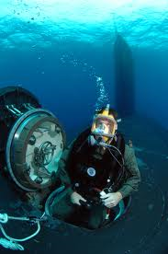
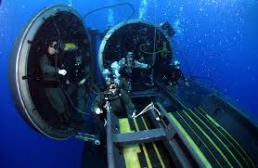
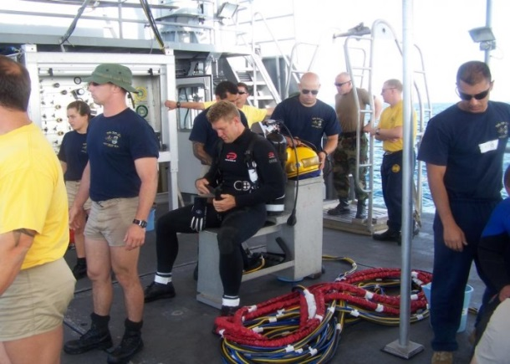
7201: Diving Officer
PERS-422
Technical specialist in underwater ship’s husbandry, salvage, SPECWAR support and undersea research.
Source Enlisted Rating: ND (Must be MMDV or M1DV)

Slide 24
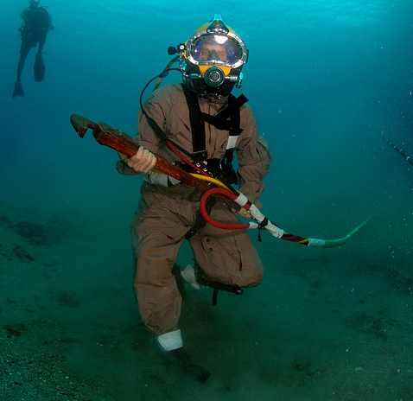

7201: Diving Officer
PERS-422
Assignments
TYCOM STAFF, SPECWAR STAFF, CSS, NDSTC, USFF; OTC
CSS, SPECWAR, NDSTC; Repair ACT
MDSU; Repair ACT; SOF; CSS; OTC; EOD
MDSU; Repair ACT; SOF; EOD
TYCOM, CNSWG, Major staff
4th Tour: TYCOM, CSS, CNSWG, NDSTC, DC,
15 YCS
CWO5
11 YCS
CWO4
3rd Tour: SOF, RF, CSS, NDSTC
7 YCS
CWO3
2nd Tour: MDSU, SOF, AS, NDSTC
3 YCS
0 YCS
CWO2
1st Tour : MDSU, SOF, AS
36 Month Tour Lengths

Slide 25
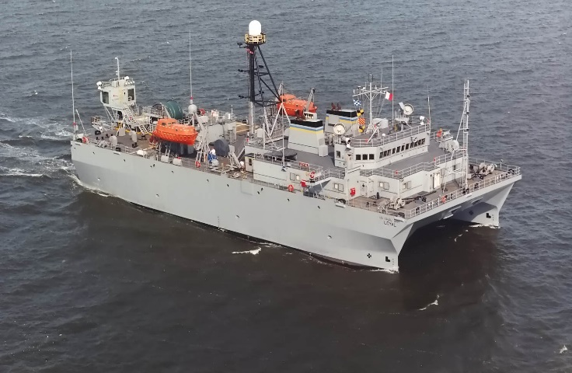
7281: Acoustic Technician
PERS-422
Established to support IUSS
  Serve as SURTASS Mission Commander, Tactical Watch Officer at Theatre Undersea Surveillance Command (TUSC) (Dam Neck and Whidbey Island, WA), various staff positions at CUS Dam Neck
  Source Enlisted Ratings: STG, STS, AW.
Applicants selected for Acoustic Technician will have a documented high degree of acoustic analytical skill.
Ideal candidates should be recognized as expert acousticians.
Possess requisite knowledge and experience of fleet anti-submarine warfare (ASW) platforms and/or the Integrated Undersea Surveillance System (IUSS).
Notes:
Surveillance Towed Array Sensor System (SURTASS)
Commander Undersea Surveillance (CUS)
1. Acoustic Intelligence Specialist 708B (0416)
2. ASW Specialist V44B (0417)
3. Sonar (Submarines) Leading Chief Petty Officer T42A (0501)
4. IUSS Master 712B (0507)
5. IUSS Journeyman 715B (0551)
6. IUSS Surveillance Towed Array Sensor System (SURTASS) Mission Commander (SMC) V59B (0553)

Slide 26
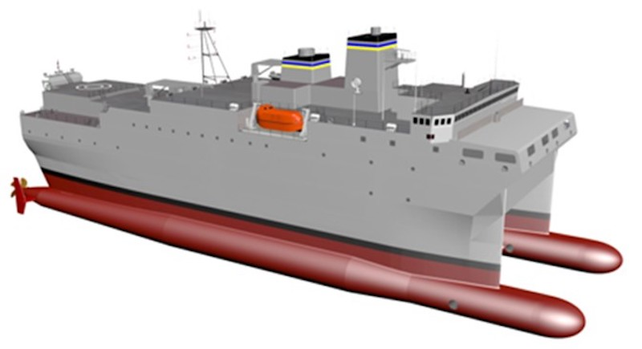
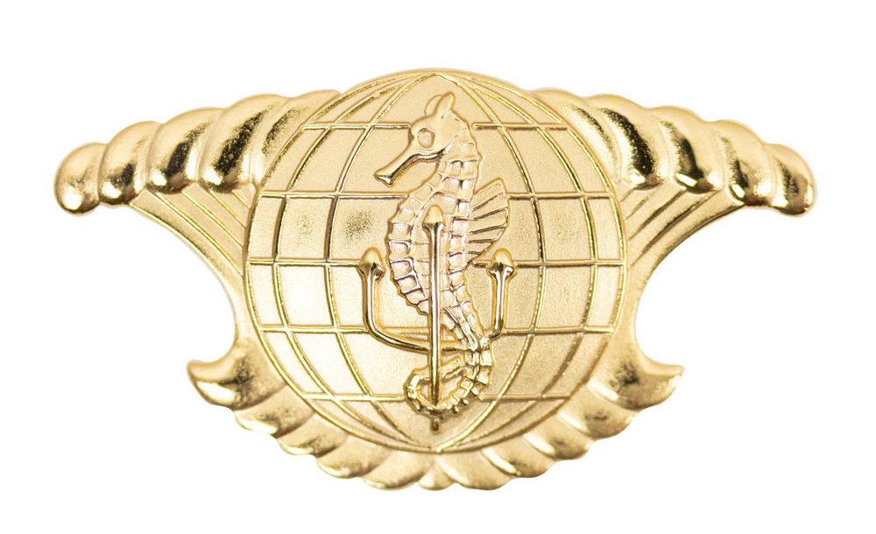
7281: Acoustic Technician
PERS-422
Assignments
TYCOM STAFF, CUS STAFF
NOPF DH; CUS STAFF; SLC OIC
SMC; NOPF TACWO; CUS QA; NOPF P&E; NOPF DH, CUS STAFF
SMC; TUSC TACWO, NDC YOKO/OKI
Milestone Position: TYCOM Staff, CUS Staff
4th Tour: SLC OIC, TUSC DH
CUS Staff
15 YCS
CWO5
11 YCS
CWO4
3rd Tour: TUSC DH, CUS Staff
2nd Tour: TUSC, SMC, NDC
7 YCS
CWO3
3 YCS
CWO2
1st Tour : SMC, TUSC, NDC
36 Month Tour Lengths

Slide 27
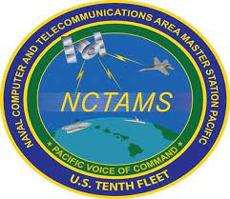
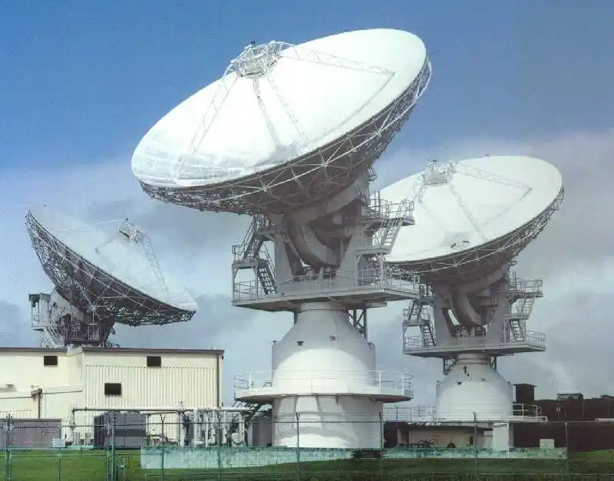

7821: Information Systems Technician
PERS-422
Technical specialists in afloat (surface and/or subsurface), ashore, tactical and NSW/expeditionary communications, cyber security and network management experiences.
Source Enlisted Rating: IT/ITS, ET/ETR who have earned the Enlisted Information Warfare Specialist (EIWS) qualification

Slide 28
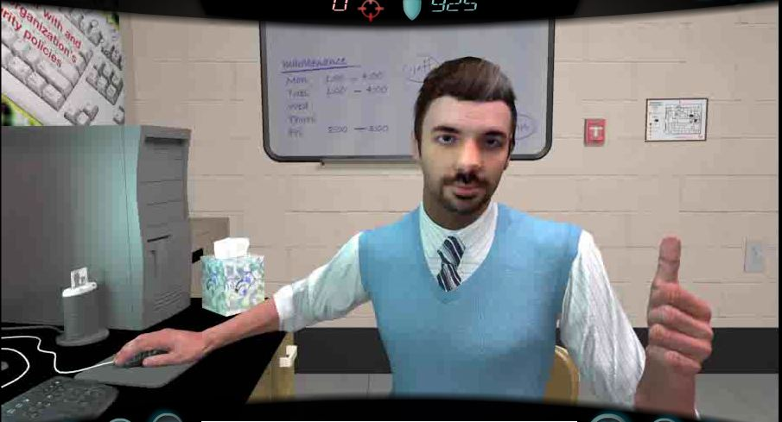
7821: Information Systems Technician
PERS-422
Assignments
NCTAMS Tech Advisor; Numbered Fleet Staff, OIC
COMMO Afloat; Info Sys Mgr; NSW/Expeditionary
COMMO Afloat; Info Sys Mgr; NSW/Expeditionary
COMMO Afloat; Info Sys Mgr; NSW/Expeditionary
#FLT Staff, NCTAMS TA, OIC
4th Tour: #FLT Staff, NCTAMS, OIC, TYCOM/SYSCOM
15 YCS
11 YCS
CWO5
3rd Tour: NCTAMS, NIWDC, DISA, TYCOM/SYSTCOM
7 YCS
CWO4
3 YCS
CWO3
2nd Tour: NCTAMS/NCTS, Sea Duty
0 YCS
CWO2
1st Tour : NCTAMS/NCTS, Sea Duty
36 Month Tour Lengths

Slide 29

Where We Serve
Specific to Submarine LDO/CWO
PERS-422
Puget Sound
All
Kittery
6260
Worldwide
Assignable (WWA)
Offutt
6290
Groton
All except 7281
DC
6260, 80, 90
7201 & 7261
Ventura
6230, 80, 90
7201
OK City
6290
Hampton Roads
All
San Diego
All except 7281
Panama City
7201
Kings Bay
All except 7281
Cape Canaveral
6230 thru 6290
7261
Pearl Harbor
All
Italy
6260 & 6290
Guam
6230 thru 6290
7201 & 7261
Key West
7201
Japan
6290 & 7281
THIS MAP IS NOT ALL-INCLUSIVE

Slide 30
LDO and CWO
Discrete Requirements

Slide 31
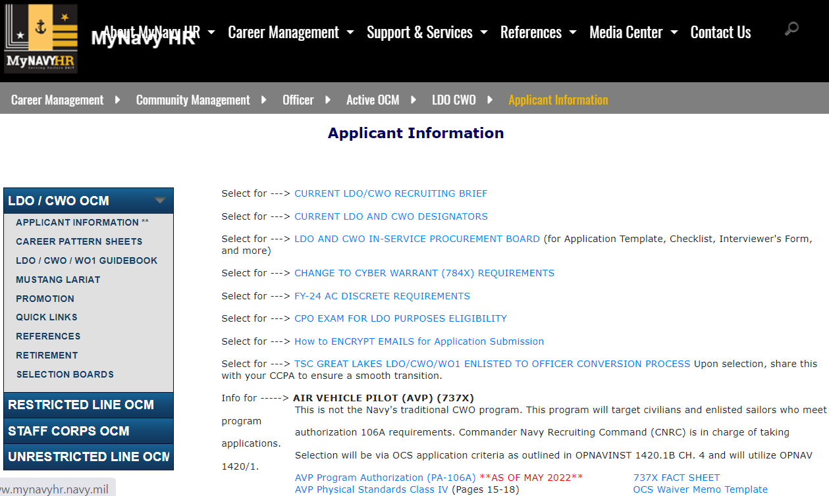
Discrete Requirements
https://www.mynavyhr.navy.mil/Career-Management/Community-Management/Officer/Active-OCM/LDO-CWO/Applicant-Information/

Slide 32
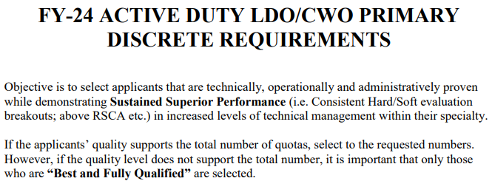
LDO and CWO Discrete Requirements
What are discrete requirements?
Outline of valued specific leadership, qualifications and technical ability written by senior in designator/community leaders which board members use as a standard for selection
What are board members looking for?
Best and most Fully Qualified Applicant
Sustained Superior Performance
Discrete Requirements are valued

Slide 33
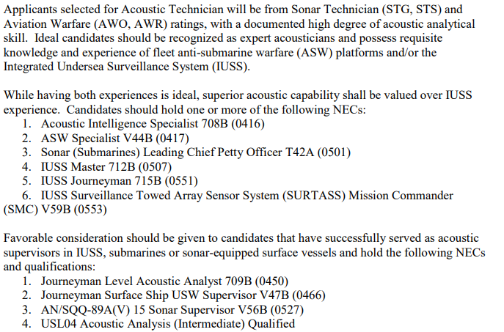
LDO and CWO Discrete Requirements

Slide 34
FY26 ISPB Application Guidance, Preparation and
Eligibility Checklist

Slide 35
FY-26 Accession Windows
Time in Service (TIS) windows (Computed to 01OCT25)
  8 to 14 years for LDO (non-nuclear) [OCT 17 – OCT 11]
  8 to 15 years for LDO off-ramp desig) [OCT 17 – OCT 10]
  8 to 16 years for LDO (nuclear) [OCT 17 – OCT 09]
  14 to 20 years for CWO (E7 and E8) [OCT 11 – OCT 05]
  14 to 22 years for CWO (E9) [OCT 11 – OCT 03]
Importance of TIS windows:
    In order to support career progression/promotion models and maximize Navy’s return on investment.
    LDO TIS waiver: 14 yrs plus 180 days
    CWO TIS waiver: 20 yrs plus 180 days
    E9 TIS waiver for CWO3: 22 yrs plus 180 days
    LDO Off-ramp and Nuclear Designators: NO TIS WAIVERS
    No waivers for less than minimum TIS!
Notes:
Changes in accession windows will:
Create a more predictable inventory for career progression
Provides time for all LDOs to compete for Captain and all CWOs to compete for CWO4 (most for CWO5)

Slide 36
Basic Components
  Application from the candidate
  Commanding Officer’s endorsement
  (3) appraisals from community leaders
Parts of your record that support your basic package:
  ESR
  PSR
  Evals
  Discrete Requirements (have been met = yes or no) – if not, missed opportunity or not afforded the opportunity?
  Properly documented Sustained Superior performance, leadership, and technical expertise – weed out Paper Tigers!
  Lifelong learning when afforded the opportunity – off-ramp designators will require it
Notes:
Changes in accession windows will:
Create a more predictable inventory for career progression
Provides time for all LDOs to compete for Captain and all CWOs to compete for CWO4 (most for CWO5)
Minimizes “early” selections from “clogging” the promotion pipeline

Slide 37
Application Key Elements
CO’s Endorsement
  Acknowledges your leadership potential and technical performance
  Can highlight qualifications (utilizing the discrete requirements)
  Can address past negatives (if needed) and waivers if applicable
  Ranking no longer required or desired
Additional Comments
  Your opportunity to speak directly to the board about your record
    Address absent discrete requirements, qualifications, broken service, etc.
    Address waivers (required waivers must be approved prior to submission)
  Limit to 100 words – simply stating “None” works – do not feel compelled to fill the white space.
  NOTE: This is NOT a personal statement, as required in past years
Notes:
12
12
CO’s must control Interview Appraisal Board process and establish and appoint board members or a command coordinator that ensures Interview Appraisals are not hand-picked by member. Interview boards must provide honest feedback to the member and to the CO on member’s qualifications and abilities as outlined per the instruction. If not ready, then DO NOT recommend at the command level, don’t leave this up to the board to filter out. Highlight accomplishments and qualifications here. Read the precepts from past boards (online). If there is any issue that needs to be brought to the boards attention, this is the best place to address it.

Slide 38
FY 26 Guidance
Review ACTIVE DUTY LIMITED DUTY OFFICER, CHIEF WARRANT OFFICER AND WARRANT OFFICER PROGRAMS OPNAVINST 1420.2 (update 3Apr2024)
Applicable NAVADMINs supersede conflicts with OPNAVINST 1420.2
Use FY-26 Active Nuclear LDO ISP Board NAVADMIN 105/24 for application guidance and deadlines (FY25 111/23)
  First Class Petty Officers awaiting CPO results, who meet all other requirements, in order to apply for CWO are encouraged to apply and submit their application by the 1 OCT 2024 deadline

Slide 39
FY-26 Guidance
Am I eligible to take the CPO Exam for LDO purposes?
BLUF: Yes, provided:
1. You are a First Class Petty Officer (A Sailor who advances to First Class Petty Officer off the March 2023 Exam, is eligible to take the January 2024 CPO Exam for LDO purposes)
2. Have command endorsement and approval.
A Sailor who advances to First Class Petty Officer off the September 2023 exam, is not eligible to apply for the upcoming LDO/CWO ISP Board and should not be recommended to participate in the immediate upcoming January 2024 CPO Exam for LDO Purposes.

Slide 40
Nuclear Power LDO
Application Requirements
https://www.mynavyhr.navy.mil/Career-Management/Community-Management/Officer/Active-OCM/LDO-CWO/Applicant-Information/
Required to be qualified EWS / PPWS. NEC N33Z must be updated in record (See Detailer)
Chiefs, Senior Chiefs, or CPO Board eligible E6
  may take CPO exam 1 year early to apply for LDO
8 – 16 years time in service
  Based off of date in associated application year NAVADMIN
  FY-26 NAVADMIN 105/24
Application Deadline: 01 OCT 24
10 year commitment
NAVADMIN supersedes other guidance

Slide 41
Applicant Preparation
  Never too early to start preparing – even as an E4
Make your chain of command aware of your goals
  Develop a strong resume with diversity of jobs (Discrete Requirements)
  Excel in your Rating Specialty
    Evaluations – Breakouts / Superior performance aligned with discrete requirements
Sea duty, Shore duty, Overseas, Special Programs, Warfare
Qual(s), Watch Station Qual(s)/Certifications
Successful LPO or LCPO tours
Work with an LDO/CWO Mentor to help you through the process
    Maximize your opportunities!
    (Master your craft)
DOES YOUR RECORD STACK UP?
41
Notes:
These are listed in order of relevance to typical board weighting. Must have good evals, soft breakouts …

Slide 42
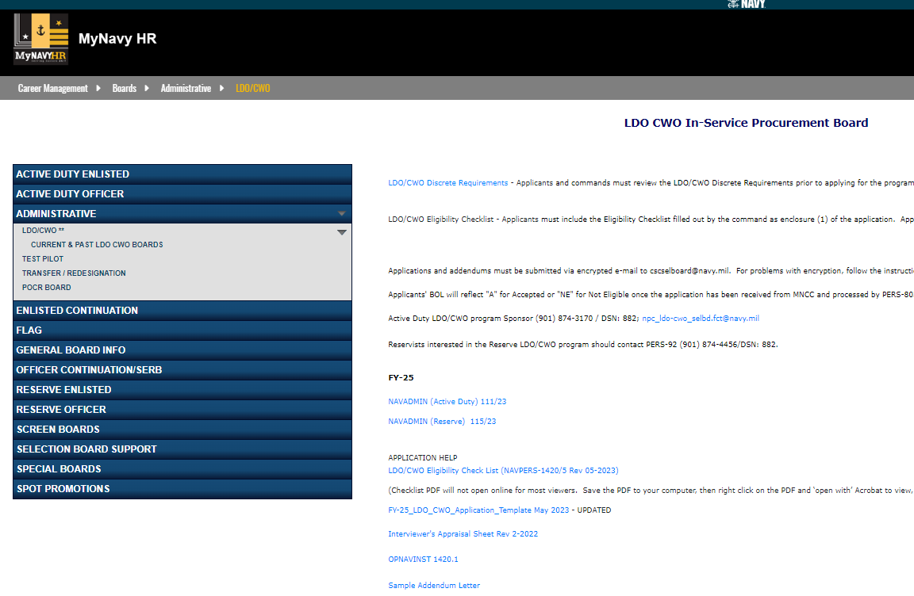
Application Key Elements
//https://www.mynavyhr.navy.mil/Career-Management/Boards/Administrative/LDO-CWO/

Slide 43
Interview Appraisal Boards
Interview Appraisal Boards (Preferred)
  Board make-up = LDO and CWO community leaders CAPT, CDR, CWO5 (Use NAVCRUIT 1131/5 (Rev. 2-2022)
  Setup by Command designated POC (Command Coordinator)
    Command POC - secure the correct designator(s) on panel
    Import board members (VTC, teleconference acceptable) when designators are not available in local area
Interview Appraisals, items to know / tips for the board:
  Your designator career path (KNOW IT!) Technical Expertise!
  Understand the commitment (world-wide assignable / impact to family)
  Answer questions honestly and directly / avoid rambling
  Relax (don’t squirm or fidget), think, speak clearly and maintain good eye contact
  You can be asked a variety of questions and each board will vary – show confidence
Appraisal Sheets belong to the CO; not the applicant!
Notes:
12
12
CO’s must control Interview Appraisal Board process and establish and appoint board members or a command coordinator that ensures Interview Appraisals are not hand-picked by member. Interview boards must provide honest feedback to the member and to the CO on member’s qualifications and abilities as outlined per the instruction. If not ready, then DO NOT recommend at the command level, don’t leave this up to the board to filter out. Highlight accomplishments and qualifications here. Read the precepts from past boards (online). If there is any issue that needs to be brought to the boards attention, this is the best place to address it.

Slide 44
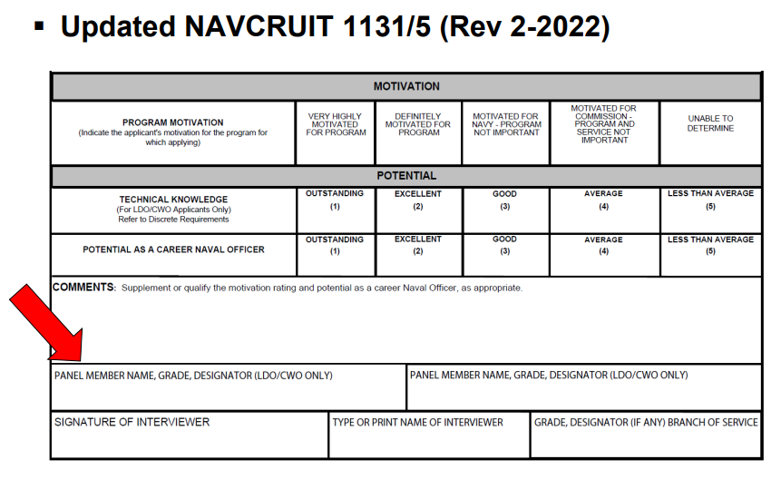
Interview Appraisal Sheet

Slide 45
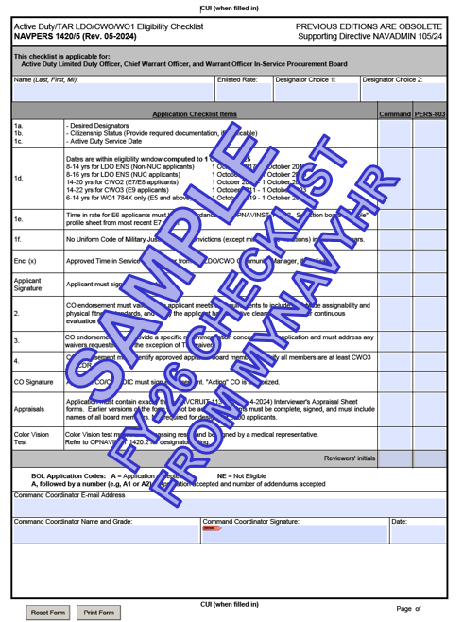
FY-26 LDO/CWO Programs
Eligibility Checklist
FY-25 Errors
Some applications had more than one error and several applicants did not meet eligibility requirements for submission.
Wrong Checklist
Appraisal Forms – Missing appraisals, missing marks, wrong form, not all Appraisers listed or names didn’t match CO’s approved names.
CO’s Endorsement – Not included, not signed or missing references requirement (“meets all requirements outlined in references (a) through (c).”)
Citizenship – Not filled out or missing documentation proof of citizenship.
Missing color vision tests for designators that require them.
Missing Security Clearance information or expired clearance.
Errors should be caught prior to their arrival at NPC. A well versed command LDO/CWO coordinator can provide assistance to both the command and the candidate during the application process.
Notes:
Follow the sample application. Don’t deviate. If in doubt, ask an LDO/CWO. Reach out to OCM/PERS-803.

Slide 46
Notional Application Timeline
MAR: Special Request to CO via Command Coordinator
May/JUN: Submit application to Admin
NLT 15 JUL: TIS waivers due to OCM
JUL/AUG: Interviewer Appraisal Board
JUL/AUG: CO’s endorsement prepared
SEP: Submit applications
NLT 01 OCT: Applications due to NPC
NLT 15 DEC: Addendums (Evals, Awards etc.) due to NPC
JAN: Board convenes
FEB/MAR: Results announced via NAVADMIN
Command Coordinator/Admin shall provide a copy of the entire completed/signed application with ALL enclosures to the applicant. This can be accomplished via paper copy or by carbon copy (cc) during electronic submission.

Slide 47
FY 25 ISPB Stats

Slide 48
FY 25 Active Duty Selections
Active Duty Quotas Selected Announced
Enlisted to LDO 221 221 219**
Enlisted to CWO 245 245 245
* Quota returned (0)
** On hold awaiting adjudication of an issue (2)
LDO Selection Opportunity: 27% (above 5 and 10 year average)
CWO Selection Opportunity: 37% (above 5 and 10 year average)
Total applications for LDO and CWO: 1,520
Eligible applications: 1,479
(LDO Apps – 824 / CWO Apps - 655)
*Note: Non-NUC applicant data

Slide 49
FY-25 Active Duty Selections
(6200 Specific)
Active Duty Quotas Selected Announced
Enlisted to ENS (LDO) 42 42 42
Total applications for FY-25 LDO: 162
Selection Opportunity LDO: 26%

Slide 50
FY 25 Stats (LDO)

Slide 51
FY 25 Stats (CWO)

Slide 52
FY-25 Selectee Profile (LDO/CWO)
“YOUR COMPETITION”
Average Age: 31 / 35
Total Years of Active Service: 12 / 17 Years
Average Years of Total Education Completed: 15 Years
Warfare Qualified: 99% / 100%
Average Number of Duty Stations: 3 / 5
Average Number of Sea/Overseas Tours: 2 / 3
IA/GSA Tours: 5% / 5%
Notes:
STATS almost identical to previous years

Slide 53
FY-25 Selectee Profile (LDO/CWO)
“YOUR COMPETITION” (6200 Specific)
Average Age: 30
Total Years of Active Service: 11.5 years (11.8 – 10yr avg)
Average Years of Total Education Completed: 14 years
Warfare Qualified: 100%
Average Number of Duty Stations: 2.5 (non-training pipeline)
Average Number of Sea / Overseas Tours: 1

Slide 54
FY 25 ISPB Overall Diversity Statistics
Eligible Selected Percent
Total Applicants* 1479 466 31.5
Female 237 63 26.6
Male 1242 403 32.4
Minority 918 268 29.2
Minority Female 193 51 26.4
Minority Male 725 217 29.9
*Note: Non-NUC applicant data

Slide 55
FY 25 ISPB Diversity Breakdown Statistics
Male Eligible Selected Percent
American Indian/Alaska Native 24 6 25.0
Asian 76 21 27.6
Black/African American 266 75 28.2
Hawaiian/Pacific American 19 7 36.8
White 497 183 36.8
Declined to Respond 20 3 15.0
Multiple Race 99 37 37.4
Hispanic Race 241 71 29.5
Total: 1242 403 32.5
Female Eligible Selected Percent
American Indian/Alaska Native 3 2 66.7
Asian 20 5 25.0
Black/African American 81 18 22.2
Hawaiian/Pacific American 4 2 50.0
White 44 12 27.3
Declined to Respond 0 0 0.00
Multiple Race 37 11 29.7
Hispanic Race 48 13 27.1
Total: 237 63 26.6
*Note: Non-NUC applicant data

Slide 56
Promotion
Opportunity

Slide 57





LDO Promotion Opportunity
CAPT 21-23 YCS 40% - 60 % Opportunity
CDR 15-17 YCS 60% - 80% Opportunity
LCDR 9 - 11 YCS 70% - 90 % Opportunity
LT 4 YCS AFQ
LTJG 2 YCS AFQ
57
Notes:
20

Slide 58



CWO Promotion Opportunity
CWO5 11-13 YCS 33 - 50%
CWO4 7 YCS 70% - 90%
CWO3 3 YCS AFQ
58

Slide 59
Return on Investment (ROI)

Slide 60
Your return on investment…
Retirement after 20 Years of Service:
CPO
$3225 / month
$38,695 / year
CWO3
$3,907 / month
$46,888 / year
LT
$4,430 / month
$53,154 / year
50% (40%)
Retirement after 26 Years of Service
SCPO
$4,739 / month
$56,871 / year
CWO4
$6,259 / month
$75,112 / year
LCDR
$6,298 / month
$75,575 / year
65% (52%)
Retirement pay for life!
DISCLAIMER: High Three Pay before taxes / BRS CALCULATED +2% per year over 20 (Does not consider members/GOVT contributions to BRS/TSp)
http://militarypay.defense.gov/Calculators/High-3-Calculator/

Slide 61
Your return on investment…
Retirement after 30 Years of Service:
MCPO
$6,728 / month
$80,733 / year
CWO4
$7,366 / month
$88,395 / year
LCDR
$7,267 / month
$87,202 / year
75% (60%)
33 Years
35 Years
38 Years
CWO5
$9,181 / month
$110,169 / year
CDR
$9,998 / month
$119,980 / year
CAPT
$13,568 / month
$162,819 / year
82.5% (66%)
87.5% (70%)
95% (76%)
Retirement pay for life!
DISCLAIMER: High Three Pay before taxes / BRS CALCULATED +2% per year over 20 (Does not consider members/GOVT contributions to BRS/TSp)
http://militarypay.defense.gov/Calculators/High-3-Calculator/

