Slide 1

Recruiting Our Future Leaders
NPC > Officer > Community Managers > Active OCM > LDO/CWO OCM > Applicant Information > CURRENT LDO/CWO RECRUITING BRIEF > Open
CAPT Ed Callahan – LDO and CWO Community Manager
LT Shanique Howard – Assistant LDO and CWO Community Manager
CWO5 Hector Sandoval – CWO Community Manager
Mr. Mitch Allen – Civilian Assistant LDO and CWO Community Manager
Unclassified

Slide 2
Topics
LDO and CWO Mission
LDO and CWO Definition
  Designators
Discrete Requirements
Guidance and Eligibility Checklist
Application Preparation
FY-20 Board statistics
Promotion Opportunity
Return on Investment (ROI)

Slide 3
LDO and CWO Mission
The Limited Duty Officer and Chief Warrant Officer Community support the war-fighting capability and readiness of Naval Forces through leadership, technical proficiency, and experience.
We are the primary manpower source for technically specific billets not best suited for traditional Unrestricted Line, Restricted Line or Staff Corps career path Officers. Using critical enlisted experience, we are committed to the continuous leadership, improvement, training and mentoring of Sailors.

Slide 4
Limited Duty Officer (LDO)
Technical Managers – LDOs are Naval Line or Staff Corps Officers that progressively advance within broad technical fields related to their former enlisted ratings
LDOs fill leadership and management positions at the ENS through CAPT level that require technical background and skills not attainable through normal development within other officer designators
LDOs serve as, but are not limited to, DIVOs, DEPT Heads, OICs, XOs and COs
Major Command (CAPT level) is the pinnacle goal!

Slide 5
LDO Designators
Line (SURFACE)
611X DECK
612X OPERATIONS
613X ENGINEERING/REPAIR
616X ORDNANCE
618X ELECTRONICS
Line (SUB / NUCLEAR)
6200 NUCLEAR POWER (NAVADMIN 006/16)
623X ENGINEERING/REPAIR
626X ORDNANCE
628X ELECTRONICS
629X COMMUNICATIONS
Line (AVIATION)
631X DECK
632X OPERATIONS
633X MAINTENANCE
636X ORDNANCE
639X AIR TRAFFIC CONTROL
General Line
641X ADMINISTRATION
643X BANDMASTER
648X EXPLOSIVE ORDNANCE DISPOSAL
649X SECURITY
Staff
653X CIVIL ENGINEER CORPS
Off-Ramp Information Warfare
681X CRYPTOLOGIC WARFARE
682X INFORMATION PROFESSIONAL
Off-Ramp Supply
651X SUPPLY CORPS
Off-ramp at LT at 5 years for IW / Supply to core Restricted Line / Staff designator; 6 years for Sub Communications
Must have completed a baccalaureate degree
Must have the appropriate Warfare device (IW / Supply)

Slide 6
Chief Warrant Officer (CWO)
Technical Specialist - CWOs are Naval Officers that possess extensive experience and knowledge to direct the most difficult and exacting operations within a given occupational specialty
Although intended primarily as technical specialists, CWOs can also serve as DIVOs, DEPT Heads or OICs
CWO assignments are “REPETITIVE” in nature
Chiefs / Senior Chiefs / “Frocked” Master Chiefs commission to CWO2
Master Chiefs, commission to CWO3 (regardless of time-in-grade)
WO1s are appointed

Slide 7
CWO designators
Line (SURFACE)
711X BOATSWAIN
712X OPERATIONS TECHNICIAN
713X ENGINEERING/REPAIR TECHNICIAN
715X SPECIAL WARFARE TECHNICIAN
716X ORDNANCE TECHNICIAN
717X SPECIAL WARFARE COMBATANT-CRAFT
718X ELECTRONICS TECHNICIAN
Line (SUB / NUCLEAR)
720X DIVING OFFICER
726X ORDNANCE TECHNICIAN
728X ACOUSTIC TECHNICIAN
Line (AVIATION)
731X BOATSWAIN
732X OPERATIONS TECHNICIAN
733X MAINTENANCE TECHNICIAN
736X ORDNANCE TECHNICIAN
Line (GENERAL / STAFF)
741X SHIP’S CLERK
752X FOOD SERVICE WARRANT
Line (INFO Warfare Community)
780X OCEANOGRAPHY WARRANT
781X CRYPTOLOGIC WARFARE TECHNICIAN
782X INFORMATION SYSTEMS TECHNICIAN
783X INTELLIGENCE TECHNICIAN
784X CYBER WARRANT

Slide 8
LDO and CWO
Discrete Requirements

Slide 9
LDO and CWO Discrete Requirements
What are discrete requirements?
  Outline of valued specific technical skill sets written by senior leadership in respective designator that board members use as a guide.
  Ex:1 Designator Discrete Requirements
  Surface Engineer - EOOW/RCO letter
  613X/713X Engineer - Superior technical knowledge/leadership in plant
  Ex: 2 Aviation Maintenance - Safe for Flight
  633X/733X - Flight Line/Deck Supervisor
What are board members looking for?
    The Best and most Fully Qualified Applicant
How do you find your designator discrete requirement?
Notes:
12
12
CO’s must control Interview Appraisal Board process and establish and appoint board members or a command coordinator that ensures Interview Appraisals are not hand-picked by member. Interview boards must provide honest feedback to the member and to the CO on member’s qualifications and abilities as outlined per the instruction. If not ready, then DO NOT recommend at the command level, don’t leave this up to the board to filter out. Highlight accomplishments and qualifications here. Read the precepts from past boards (online). If there is any issue that needs to be brought to the boards attention, this is the best place to address it.

Slide 10
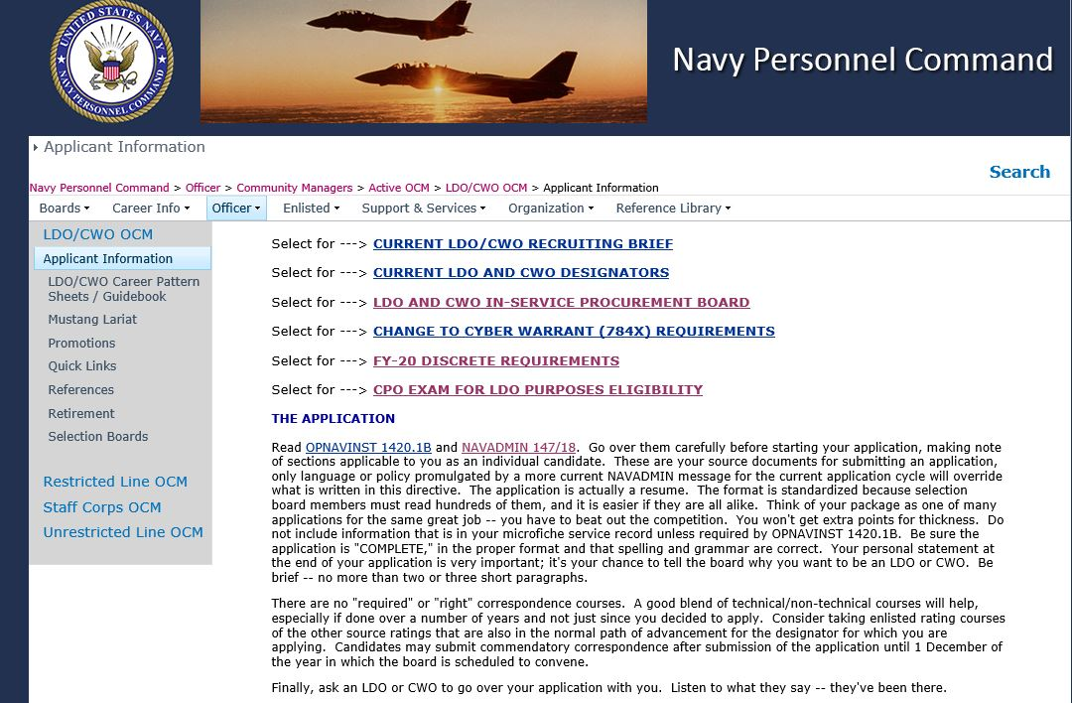
LDO and CWO Discrete Requirements
Navy Personnel Command > Officer > Community Managers > Active OCM > LDO/CWO OCM > Applicant Information

Slide 11
LDO and CWO Discrete Requirements

Slide 12
Guidance and
Eligibility Checklist

Slide 13
FY-21 Accession Windows
Time in Service (TIS) windows (Computed to 01OCT20)
  8 to 14 years for LDO (non-nuclear) [OCT 12 – OCT 06]
  8 to 16 years for LDO (nuclear) [OCT 12 – OCT 04]
  14 to 20 years for CWO (E7 and E8) [OCT 06 – OCT 00]
  14 to 22 years for CWO (E9) [OCT 06 – OCT 98]
  TIS waivers for LDO and CWO will not be considered
  Why?
    In order to support career progression/promotion models and maximize Navy’s return on investment.
Notes:
Changes in accession windows will:
Create a more predictable inventory for career progression
Provides time for all LDOs to compete for Captain and all CWOs to compete for CWO4 (most for CWO5)
Minimizes “early” selections from “clogging” the promotion pipeline

Slide 14
Guidance
Review Enlisted to Officer Commissioning Programs Application Administrative Manual OPNAVINST 1420.1B, Ch 2, and 7
Applicable NAVADMINs supersede conflicts with OPNAVINST 1420.1B
NAVADMIN 147/18 (FY 20 Active LDO and CWO ISP Board) Highlights
  LDO applicants for 651X, 681X, and 682X can apply up to 15 yrs TIS
  Navy Divers (ND) can apply for 623X Submarine Engineer
  Cyber Warrant applicants refer to NAVADMIN 140/18 for requirements
  Minimum grade for interview appraisal board member must be a LT or CWO3
  Three interview appraisals (NAVCRUIT 1131/5 - Rev 05/2017)
  Application submission via email
Applying for additional designators
  Must have documented technical and leadership experience
  A degree is not a substitute for technical experience
  OPNAVINST 1420.1B (Ch 7, para 18) outlines normal path
FY-21 NAVADMIN is en route

Slide 15
Applicant Preparation
  Never too early to start preparing – even as an E4
Make your chain of command aware of your goals
  Develop a strong resume with diversity of jobs
  Excel in your Rating Specialty
    Evaluations – Breakouts / Superior performance aligned with discrete requirements
Sea duty, Shore duty, Overseas, Special Programs, Warfare
Qual(s), Watch Station Qual(s)/Certifications
Successful LPO or LCPO tours
Work with an LDO/CWO Mentor to help you through the process
    Maximize your opportunities!
    (Master your craft)
DOES YOUR RECORD STACK UP?
15
Notes:
These are listed in order of relevance to typical board weighting. Must have good evals, soft breakouts …

Slide 16
Application
Key Elements
CO’s Endorsement
  Acknowledges your leadership potential and technical performance
  Can highlight qualifications (utilize the discrete requirements)
  Can address past negatives (if needed) and waivers if applicable
Personal Statements
  Your opportunity to speak directly to the board
  Be “ORIGINAL”, make it your statement vice a plagiarized copy
  Reason applying for a commission
  Personal and professional goals
  Strengths/personal characteristics YOU possess which will contribute to success as an LDO or CWO (highlight your leadership potential)
Notes:
12
12
CO’s must control Interview Appraisal Board process and establish and appoint board members or a command coordinator that ensures Interview Appraisals are not hand-picked by member. Interview boards must provide honest feedback to the member and to the CO on member’s qualifications and abilities as outlined per the instruction. If not ready, then DO NOT recommend at the command level, don’t leave this up to the board to filter out. Highlight accomplishments and qualifications here. Read the precepts from past boards (online). If there is any issue that needs to be brought to the boards attention, this is the best place to address it.

Slide 17
Interview Appraisal Boards
Interview Appraisal Boards
  Endorsement by the LDO and CWO community
  Setup by the Command designated POC
    Command POC - get the right designator(s) on panel
    Import board members if needed (VTC, teleconference acceptable)
Interview Appraisals, items to know / tips for the board:
  Your designator career path (KNOW IT!)
  Understand the commitment (world wide assignable and impact to family)
  Answer the questions honestly and directly / avoid rambling
  Relax (don’t squirm or fidget), think, speak clearly and maintain good eye contact
  You can be asked a variety of questions and each board will vary – show confidence
Appraisal Sheets belong to the CO; not the applicant!
Notes:
12
12
CO’s must control Interview Appraisal Board process and establish and appoint board members or a command coordinator that ensures Interview Appraisals are not hand-picked by member. Interview boards must provide honest feedback to the member and to the CO on member’s qualifications and abilities as outlined per the instruction. If not ready, then DO NOT recommend at the command level, don’t leave this up to the board to filter out. Highlight accomplishments and qualifications here. Read the precepts from past boards (online). If there is any issue that needs to be brought to the boards attention, this is the best place to address it.

Slide 18
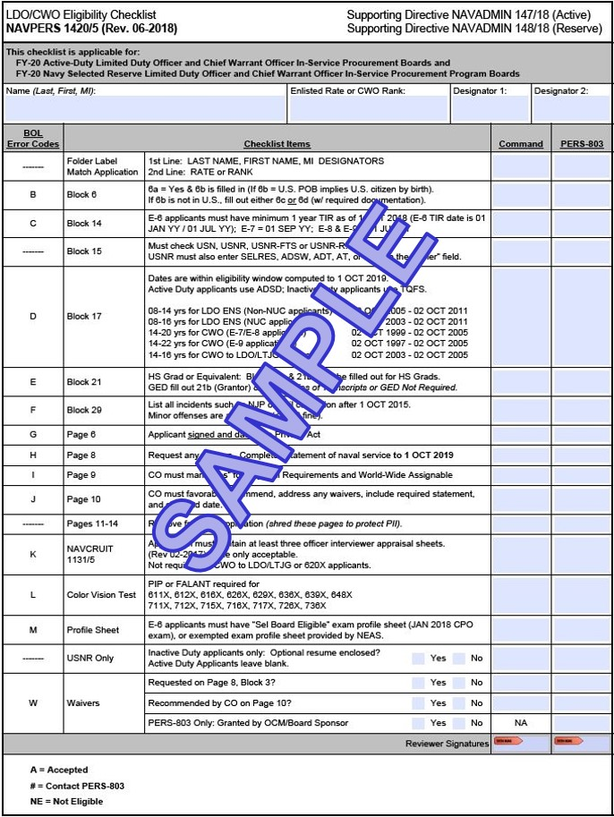
FY-20 LDO/CWO Programs
Eligibility Checklist
Navy Personnel Command > Boards > Administrative >
LDO/CWO > FY-20LDO/CWO Checklist > Open
FY-20 Errors
Average is 11% of packages had errors; 89% accepted. (Some applications had more than one error and several applicants did not meet requirements for submission)
Appraisal Forms - Most common error. Most current form was not used or they were not submitted with the application. (New Appraisal Form will be available this year)
Block 29 – (Civil/Military Offenses) – Second most common error was military/civilian convictions. (Error code F)
Page 10 – CO’s Endorsement – Required statement (“applicant meets all requirements of….”), was wrong or missing. (Error code J)
Block 21 (High School) and Block 6 (Citizenship) – Errors continued this year. (Error codes B and E)
Missing color vision tests for designators that require them. (Error code L)
Most of these errors should be caught prior to their arrival at NPC. A well versed command LDO/CWO coordinator can provide assistance to both the command and the candidate during the application process.

Slide 19
Notional Application Timeline
MAR: Special Request to CO via Command Coordinator
May: Submit application to Admin
JUN: Interviewer Appraisal Board
JUL: CO’s endorsement prepared
SEP: Email applications
NLT 01 OCT: Applications due to NPC
NLT 01 DEC: Routine Addendums received by NPC
NLT 01 JAN: Evals and Awards received by NPC
JAN: Board convenes
MAR: Results announced via NAVADMIN
Command Coordinator/Admin shall provide a copy of the entire completed/signed application with ALL enclosures to the applicant. This can be accomplished via paper copy or by carbon copy (cc) during electronic submission.

Slide 20
FY-20 Active Duty Selections
Active Duty Quotas Selected Announced
Enlisted to ENS (LDO) 277 277 276
Enlisted to CWO 224 219 * 212
CWO to LTJG * * 3 3 3
Selection Opportunity FY-20 LDO: 16%
Selection Opportunity FY-20 CWO: 24%
Total applications for FY-20 LDO and CWO: 2,607
Eligible applications: 2,316
* Returned Quotas 7121(3), 7321(1) and 7841(1)
** Applicable to IW/IP CWOs only
(Includes NUC Selections)
(LDO Apps - 1706 / CWO Apps - 901)

Slide 21
FY-20 Selectee Profile (LDO/CWO)
“YOUR COMPETITION”
Average Age: 32 / 36
Total Years of Active Service: 11 / 16 Years
Average Years of Total Education Completed: 14 Years
Warfare Qualified: 98% / 100%
Average Number of Duty Stations: 4 / 5
Average Number of Sea/Overseas Tours: 2 / 3
IA/GSA Tours: 6% / 7%

Slide 22
FY-20 Stats (LDO)

Slide 23
FY-20 Stats (CWO)

Slide 24
Promotion
Opportunity

Slide 25





LDO Promotion Opportunity
CAPT 21-23 YCS 40% - 60 % Opportunity
CDR 15-17 YCS 60% - 80% Opportunity
LCDR 9 - 11 YCS 70% - 90 % Opportunity
LT 4 YCS AFQ
LTJG 2 YCS AFQ
25
Notes:
20

Slide 26



CWO Promotion Opportunity
CWO5 13 YCS 40% typical
CWO4 7 YCS 70% - 90% Opportunity
CWO3 3 YCS AFQ
WO1 to CWO2 – Refer to SECNAVINST 1412.8C
26

Slide 27
Your return on investment…
Retirement after 20 Years of Service:
CPO
$2,350 / month
$28,198 / year
CWO3
$3,133 / month
$37,597 / year
LT
$3,692 / month
$44,304 / year
50% (40%)
Retirement after 26 Years of Service
SCPO
$3,707 / month
$44,478 / year
CWO4
$5,029 / month
$60,346 / year
LCDR
$5,281 / month
$63,373 / year
65% (52%)
Retirement pay for life!
DISCLAIMER: High Three Pay before taxes / BRS CALCULATED +2% per year over 20 (Does not consider members/GOVT contributions to BRS/TSp)
http://militarypay.defense.gov/Calculators/Active-Duty-Retirement/High-36-Calculator/

Slide 28
Your return on investment…
Retirement after 30 Years of Service:
MCPO
$5,339 / month
$64,071 / year
CWO4
$6,078 / month
$72,939 / year
LCDR
$6,088 / month
$73,061 / year
75% (60%)
33 Years
35 Years
38 Years
CWO5
$7,707 / month
$92,488 / year
CDR
$8,371 / month
$100,447 / year
CAPT
$11,356 / month
$136,266 / year
82.5% (66%)
87.5% (70%)
95% (76%)
Retirement pay for life!
DISCLAIMER: High Three Pay before taxes / BRS CALCULATED +2% per year over 20 (Does not consider members/GOVT contributions to BRS/TSp)
http://militarypay.defense.gov/Calculators/Active-Duty-Retirement/High-36-Calculator/

Slide 29
Contact Us
CAPT Ed Callahan, Head LDO and CWO Community Manager,
email: edward.l.callahan@navy.mil
LT Shanique Howard– Assistant LDO and CWO Community Manager
email: shanique.d.howard@navy.mil
CWO5 Hector Sandoval, CWO Community Manager,
email: hector.sandoval@navy.mil
Mitch Allen, Civilian Assistant LDO and CWO Community Manager,
email: mitchell.allen@navy.mil
Community News and Forums:
NPC Website:
http://www.npc.navy.mil/officer/communitymanagers/ldo_cwo
Facebook : Search, “LDO/CWO Community Managers Forum”

