Slide 1

https://www.mynavyhr.navy.mil/Career-Management/Community-Management/Officer/Active-OCM/LDO-CWO/Applicant-Information/
Recruiting Our Future Leaders
CAPT Dave Dwyer– LDO/CWO Community Manager
LT Bryan Gill– Assistant LDO/CWO Community Manager
CWO5 Hector Sandoval – CWO Community Manager
Mr. Parker Dinwiddie – Civilian Assistant LDO/CWO Community Manager
Unclassified

Slide 2
Topics
LDO and CWO Mission
LDO and CWO Definition
  Designators
Discrete Requirements
Guidance and Eligibility Checklist
Application Preparation
FY-22 Board statistics
Promotion Opportunity
Return on Investment (ROI)

Slide 3
LDO and CWO Mission
The Limited Duty Officer and Chief Warrant Officer Community support the war-fighting capability and readiness of Naval Forces through leadership, technical proficiency, and experience.
We are the primary manpower source for technically specific billets not best suited for traditional Unrestricted Line, Restricted Line or Staff Corps career path Officers. Using critical enlisted experience, we are committed to the continuous leadership, improvement, training and mentoring of Sailors.

Slide 4
Limited Duty Officer (LDO)
Technical Managers – LDOs are Naval Line or Staff Corps Officers that progressively advance within broad technical fields related to their former enlisted ratings
LDOs fill leadership and management positions at the ENS through CAPT level that require technical background and skills not attainable through normal development within other officer designators
LDOs serve as, but are not limited to, DIVOs, DEPT Heads, OICs, XOs and COs
Major Command (CAPT level) is the pinnacle goal!

Slide 5
LDO Designators
Line (SURFACE)
611X DECK
612X OPERATIONS
613X ENGINEERING/REPAIR
618X ELECTRONICS
Line (SUB / NUCLEAR)
6200 NUCLEAR POWER (NAVADMIN 006/16)
623X ENGINEERING/REPAIR
626X ORDNANCE
628X ELECTRONICS
*629X COMMUNICATIONS
Line (AVIATION)
631X DECK
633X MAINTENANCE
636X ORDNANCE
639X AIR TRAFFIC CONTROL
General Line
641X ADMINISTRATION
643X BANDMASTER
648X EXPLOSIVE ORDNANCE DISPOSAL
649X SECURITY
Staff
653X CIVIL ENGINEER CORPS
Information Warfare
*681X CRYPTOLOGIC WARFARE
*682X INFORMATION PROFESSIONAL
Supply
*651X SUPPLY CORPS
* Applicants for LDO off-ramp designators must comprehend designator specific off-ramp requirements and procedures as defined in NAVADMIN 128/19 (629X) or NAVADMIN 014/18 (651X, 681X and 682X)
LT at 5 years for IW / Supply to core Restricted Line / Staff designator
LT at 6 years for Sub Communications to core Restricted Line
Must have completed a baccalaureate degree
Must have appropriate Warfare device (IW / Supply)

Slide 6
Chief Warrant Officer (CWO)
Technical Specialist - CWOs are Naval Officers that possess extensive experience and knowledge to direct the most difficult and exacting operations within a given occupational specialty
Although intended primarily as technical specialists, CWOs can also serve as DIVOs, DEPT Heads or OICs
CWO assignments are “REPETITIVE” in nature
Chiefs / Senior Chiefs / “Frocked” Master Chiefs commission to CWO2
Master Chiefs, commission to CWO3 (regardless of time-in-grade)
WO1s are appointed

Slide 7
CWO Designators
Line (SURFACE)
711X BOATSWAIN
712X OPERATIONS TECHNICIAN
713X ENGINEERING/REPAIR TECHNICIAN
715X SPECIAL WARFARE TECHNICIAN
717X SPECIAL WARFARE COMBATANT-CRAFT
718X ELECTRONICS TECHNICIAN
Line (SUB / NUCLEAR)
720X DIVING OFFICER
726X ORDNANCE TECHNICIAN
728X ACOUSTIC TECHNICIAN
Line (AVIATION)
731X BOATSWAIN
732X OPERATIONS TECHNICIAN
733X MAINTENANCE TECHNICIAN
736X ORDNANCE TECHNICIAN
737X AERIAL VEHICLE OPERATOR (OCS WO1)
Line (GENERAL / STAFF)
741X SHIP’S CLERK
752X FOOD SERVICE WARRANT
749X SECURITY TECHNICIAN
Line (INFO Warfare Community)
780X OCEANOGRAPHY WARRANT
781X CRYPTOLOGIC WARFARE TECHNICIAN
782X INFORMATION SYSTEMS TECHNICIAN
*783X INTELLIGENCE TECHNICIAN
  CI/HUMINT
  GEOINT/Targeting
  OPINTEL
784X CYBER WARRANT (WO1 Only)
* Intelligence (783X) CWO applicants will be
considered for selection into one of three
Core Competency Areas (CCA)

Slide 8
LDO and CWO
Discrete Requirements

Slide 9
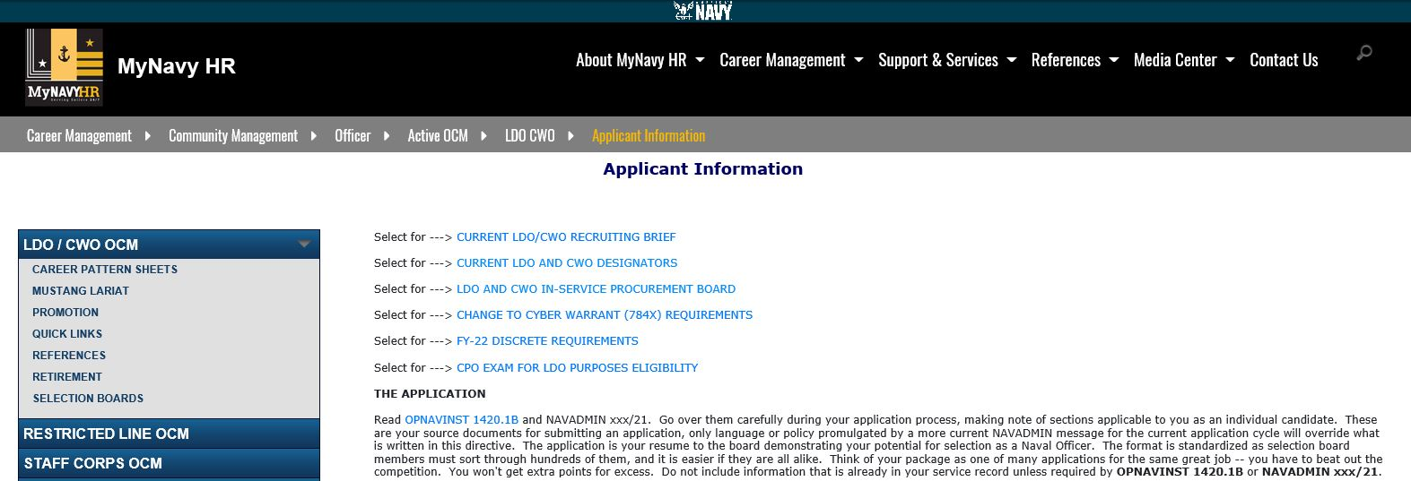
Discrete Requirements
https://www.mynavyhr.navy.mil/Career-Management/Community-Management/Officer/Active-OCM/LDO-CWO/Applicant-Information/

Slide 10
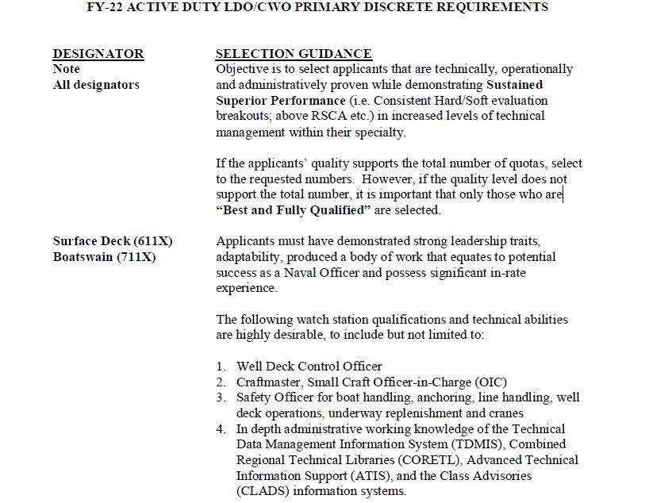
LDO and CWO Discrete Requirements
What are discrete requirements?
Outline of valued specific leadership, qualifications and technical ability written by senior in designator/community leaders which board members use as a standard for selection
Designator Discrete Requirements
Surface Engineer - EOOW/RCO letter
613X/713X - Superior technical knowledge/
Leadership in plant
Aviation Maint - Safe for Flight
633X/733X - Flight Line/Deck Supervisor
What are board members looking for?
- Best and most Fully Qualified Applicant
- Sustained Superior Performance

Slide 11
Guidance and
Eligibility Checklist

Slide 12
FY-23 Accession Windows
Time in Service (TIS) windows (Computed to 01OCT22)
  8 to 14 years for LDO (non-nuclear) [OCT 14 – OCT 08]
  8 to 16 years for LDO (nuclear) [OCT 14 – OCT 06]
  14 to 20 years for CWO (E7 and E8) [OCT 08 – OCT 02]
  14 to 22 years for CWO (E9) [OCT 08 – OCT 00]
  Importance of our TIS windows:
    In order to support career progression/promotion models and maximize Navy’s return on investment.
Notes:
Changes in accession windows will:
Create a more predictable inventory for career progression
Provides time for all LDOs to compete for Captain and all CWOs to compete for CWO4 (most for CWO5)
Minimizes “early” selections from “clogging” the promotion pipeline

Slide 13
FY-23 Guidance
Review Enlisted to Officer Commissioning Programs Application Administrative Manual OPNAVINST 1420.1B, Ch 2, and 7
Applicable NAVADMINs supersede conflicts with OPNAVINST 1420.1B
Use FY-23 Active LDO and CWO ISP Board NAVADMIN (pending) for application guidance and deadlines
  First Class Petty Officers awaiting CPO results, who meet all other requirements, in order to apply for CWO are encouraged to apply and submit their application by the 1 OCT 2021 deadline
Applying for additional designators
  Must have documented technical and leadership experience
  A degree is not a substitute for technical experience
  OPNAVINST 1420.1B (Ch 7, para 18) outlines normal path

Slide 14
Applicant Preparation
  Never too early to start preparing – even as an E4
Make your chain of command aware of your goals
  Develop a strong resume with diversity of jobs (Discrete Requirements)
  Excel in your Rating Specialty
    Evaluations – Breakouts / Superior performance aligned with discrete requirements
Sea duty, Shore duty, Overseas, Special Programs, Warfare
Qual(s), Watch Station Qual(s)/Certifications
Successful LPO or LCPO tours
Work with an LDO/CWO Mentor to help you through the process
    Maximize your opportunities!
    (Master your craft)
DOES YOUR RECORD STACK UP?
14
Notes:
These are listed in order of relevance to typical board weighting. Must have good evals, soft breakouts …

Slide 15
Application
Key Elements
CO’s Endorsement
  Acknowledges your leadership potential and technical performance
  Can highlight qualifications (utilizing the discrete requirements)
  Can address past negatives (if needed) and waivers if applicable
Additional Comments
  Your opportunity to speak directly to the board about your record
    Address absent discrete requirements, qualifications, broken service, etc.
    Address waivers (required waivers must be approved prior to submission)
  Limit to 100 words
  NOTE: This is NOT a personal statement, as required in past years
Notes:
12
12
CO’s must control Interview Appraisal Board process and establish and appoint board members or a command coordinator that ensures Interview Appraisals are not hand-picked by member. Interview boards must provide honest feedback to the member and to the CO on member’s qualifications and abilities as outlined per the instruction. If not ready, then DO NOT recommend at the command level, don’t leave this up to the board to filter out. Highlight accomplishments and qualifications here. Read the precepts from past boards (online). If there is any issue that needs to be brought to the boards attention, this is the best place to address it.

Slide 16
Interview Appraisal Boards
Interview Appraisal Boards (Preferred)
  Endorsement by LDO and CWO community leaders
  Use NAVCRUIT 1131/5 (Rev. 3-2021)
  Applicants do not “Appraisal Shop”
  Setup by Command designated POC (Command Coordinator)
    Command POC - secure the correct designator(s) on panel
    Import board members (VTC, teleconference acceptable) when designators are not available in local area
Interview Appraisals, items to know / tips for the board:
  Your designator career path (KNOW IT!)
  Understand the commitment (world-wide assignable / impact to family)
  Answer questions honestly and directly / avoid rambling
  Relax (don’t squirm or fidget), think, speak clearly and maintain good eye contact
  You can be asked a variety of questions and each board will vary – show confidence
Appraisal Sheets belong to the CO; not the applicant!
Notes:
12
12
CO’s must control Interview Appraisal Board process and establish and appoint board members or a command coordinator that ensures Interview Appraisals are not hand-picked by member. Interview boards must provide honest feedback to the member and to the CO on member’s qualifications and abilities as outlined per the instruction. If not ready, then DO NOT recommend at the command level, don’t leave this up to the board to filter out. Highlight accomplishments and qualifications here. Read the precepts from past boards (online). If there is any issue that needs to be brought to the boards attention, this is the best place to address it.

Slide 17
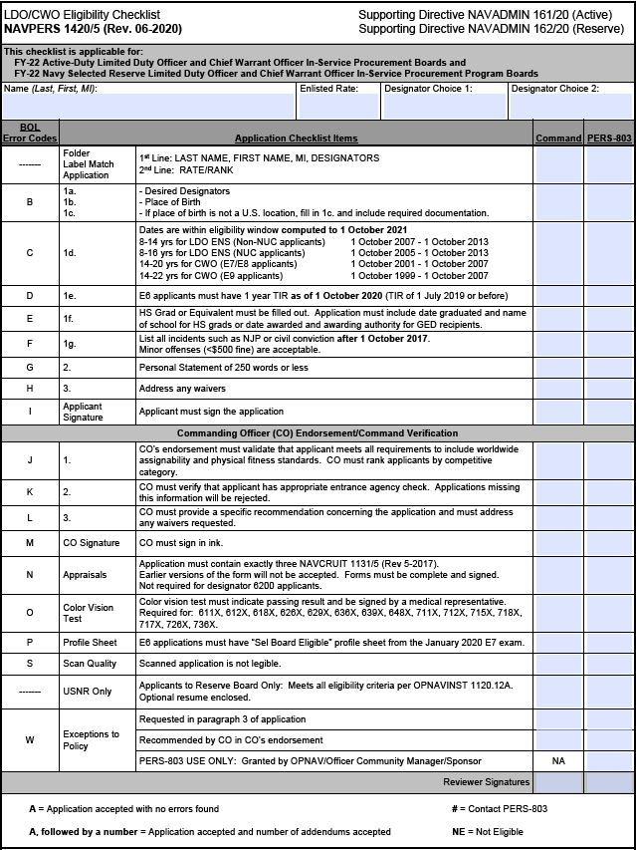
FY-23 LDO/CWO Programs
Eligibility Checklist
FY-22 Errors
Some applications had more than one error and several applicants did not meet requirements for submission
Appraisal Forms – Missing appraisals, missing marks, current form not used (Digital Signature Appraisal Form) (NAVCRUIT 1131/5 - Rev 05/2017)
CO’s Endorsement – Not included, not signed or missing references requirement (“meets all requirements outlined in references (a) through (c).”)
Citizenship – Not filled out or missing documentation proof of citizenship
Missing color vision tests for designators that require them.
Missing Security Clearance information
Most of these errors should be caught prior to their arrival at NPC. A well versed command LDO/CWO coordinator can provide assistance to both the command and the candidate during the application process.
SAMPLE
USE UPDATED
FY-23 CHECKLIST

Slide 18
Notional Application Timeline
MAR: Special Request to CO via Command Coordinator
May: Submit application to Admin
JUN: Interviewer Appraisal Board
JUL: CO’s endorsement prepared
SEP: Email applications
NLT 01 OCT: Applications due to NPC
NLT 15 DEC: Addendums (Evals, Awards etc.) due to NPC
JAN: Board convenes
MAR: Results announced via NAVADMIN
Command Coordinator/Admin shall provide a copy of the entire completed/signed application with ALL enclosures to the applicant. This can be accomplished via paper copy or by carbon copy (cc) during electronic submission.

Slide 19
FY-22 Active Duty Selections
Active Duty Quotas Selected Announced
Enlisted to ENS (LDO) 274 *272 **271
Enlisted to CWO 234 *231 **230
CWO to LTJG 0 0 0
* Quotas returned
** On hold awaiting adjudication of an issue
Selection Opportunity FY-22 LDO: 18%
Selection Opportunity FY-22 CWO: 26%
Total applications for FY-22 LDO and CWO: 2,404
Eligible applications: 2,203
(Includes NUC Selections)
(LDO Apps - 1587 / CWO Apps - 817)

Slide 20
FY-22 Selectee Profile (LDO/CWO)
“YOUR COMPETITION”
Average Age: 31 / 35
Total Years of Active Service: 12 / 17 Years
Average Years of Total Education Completed: 15 Years
Warfare Qualified: 98% / 100%
Average Number of Duty Stations: 3 / 5
Average Number of Sea/Overseas Tours: 2 / 3
IA/GSA Tours: 7% / 16%

Slide 21
FY-22 Stats (LDO)

Slide 22
FY-22 Stats (CWO)

Slide 23
Promotion
Opportunity

Slide 24





LDO Promotion Opportunity
CAPT 21-23 YCS 40% - 60 % Opportunity
CDR 15-17 YCS 60% - 80% Opportunity
LCDR 9 - 11 YCS 70% - 90 % Opportunity
LT 4 YCS AFQ
LTJG 2 YCS AFQ
24
Notes:
20

Slide 25



CWO Promotion Opportunity
CWO5 13 YCS 33 - 50% typical
CWO4 7 YCS 70% - 90% Opportunity
CWO3 3 YCS AFQ
WO1 to CWO2 – Refer to SECNAVINST 1412.8C
25

Slide 26
Your return on investment…
Retirement after 20 Years of Service:
CPO
$2,547 / month
$30,570 / year
CWO3
$3,457 / month
$41,490 / year
LT
$3,919 / month
$47,034 / year
50% (40%)
Retirement after 26 Years of Service
SCPO
$4,193 / month
$50,325 / year
CWO4
$5,538 / month
$66,463 / year
LCDR
$5,573 / month
$66,877 / year
65% (52%)
Retirement pay for life!
DISCLAIMER: High Three Pay before taxes / BRS CALCULATED +2% per year over 20 (Does not consider members/GOVT contributions to BRS/TSp)
http://militarypay.defense.gov/Calculators/High-3-Calculator/

Slide 27
Your return on investment…
Retirement after 30 Years of Service:
MCPO
$5,953 / month
$71,442 / year
CWO4
$6,518 / month
$78,219 / year
LCDR
$6,430 / month
$77,166 / year
75% (60%)
33 Years
35 Years
38 Years
CWO5
$7,999 / month
$95,993 / year
CDR
$8,945 / month
$107,343 / year
CAPT
$12,006 / month
$144,073 / year
82.5% (66%)
87.5% (70%)
95% (76%)
Retirement pay for life!
DISCLAIMER: High Three Pay before taxes / BRS CALCULATED +2% per year over 20 (Does not consider members/GOVT contributions to BRS/TSp)
http://militarypay.defense.gov/Calculators/High-3-Calculator/

Slide 28
Contact Us
CAPT Dave Dwyer, Head LDO/CWO Community Manager
email: david.dwyer2@navy.mil
LT Bryan Gill, Assistant LDO/CWO Community Manager
email: bryan.j.gill@navy.mil
CWO5 Hector Sandoval, CWO Community Manager
email: hector.sandoval@navy.mil
Parker Dinwiddie , Civilian Assistant LDO/CWO Community Manager
email: parker.h.dinwiddie@navy.mil
* LDO/CWO OCM Mailbox: ldocwoocm.fct@navy.mil
Community News and Forums:
MyNavyHR Website:
https://www.mynavyhr.navy.mil/Career-Management/Community-Management/Officer/Active-OCM/LDO-CWO
Facebook: Search, “US Navy LDO/CWO Community Managers Forum”

